Slide 1
2015 Fall Product Program
Troop Training

Slide 2
Changes for 2015
New Trophy Nut product – Sweet ‘n’ Crunchy Trail mix—new price point, $10. Replaces Tomato Basil Peanuts.
TNOS and eNuts+ have one log-in
Customizable avatar patch for nuts
Customizable giraffe mascot patch for magazines
Magazine orders automatically entered in TNOS/eNuts+ by council
Parents can enter girl nut orders
New Digital Magazine option—like Netflix for magazines
2015 Fall Product Program

Slide 3
September
p. 5
Early September
Girl & parent meetings
September 25
ACH form, troop check & Troop Fall Product Chair Position form due to SUFPC
October 2
Troops receive access to TNOS/eNuts+
View/print TNOS/eNuts+ manual at www.girlscoutsla.org
Order taking begins
Questions???
2015 Fall Product Program

Slide 4
October
October 16
Nut orders due to troop
Parents enter nut orders
eNuts+ “Order Promises” for girl delivery end at 9 PM
October 17-18
TFPC enters orders in TNOS
October 30-November 2
Nut delivery to troops
Questions???
2015 Fall Product Program

Slide 5
November
November 1-8
Walkabouts and Lemonade Stands – no boothing!
November 8
Fall Product Program ends
November 9
Parents and TFPCs receive QSP Girl’s Online Sales Report email
November 13
Final day to enter allocations and troop-to-troop transfers
November 20
ACH debit to troop accounts
Questions???
2015 Fall Product Program

Slide 6
Fall Product Central Homepage
Note the 3 login links
2015 Fall Product Program

Slide 7
Pre-Planning Checklist p. 6
New troops open a bank account
Turn in signed ACH Debit Authorization and Troop Fall Product Chair Position & Agreement forms to SUFPC
Girls must turn in Parent/Guardian Permission & Responsibility Agreement
Train girls and parents
Review Safety Activity Checkpoints
“Like” GSGLA Cookie & Nut Friends on Facebook
2015 Fall Product Program

Slide 8
Parent & Girl Training Agenda
p. 7
Inspire! Encourage! Motivate!
Fall Product Program is to generate start-up funds until Cookies gets here
5 Skills for Girls
Troop and girl goals
Dates and deadlines
Money Handling
2015 Fall Product Program

Slide 9
Materials p. 8
Each girl receives
Order Card
Money Envelope
Family Letter
QSP Magazine Order Envelope
Spread the Word Business Cards
Each troop receives
Program Activity Poster
Envelopes
Receipt Book
GOC receipts
2015 Fall Product Program

Slide 10
Online Access p. 8
Two software programs
TNOS/eNuts+ are now combined
QSP
Troops access TNOS through eNuts+ and use the combined sites to manage the Fall Product Program
Parents/girls access eNuts+ and QSP websites to send emails to customers and create custom avatar/giraffe patches
2015 Fall Product Program

Slide 11
eNuts+
p. 9
Option of girl delivery (until Oct. 16) or ship to customer
Girl Delivery
Customers can order our 15 items
Rolls into girl’s nut order in TNOS
Customer pays upon delivery, saving the shipping costs
Shipped:
25 Girl Scout products, as well as gift items
Customer pays by credit card online
Girls/troops do not handle product or payment
Customer pays for shipping
Order is automatically entered into TNOS
2015 Fall Product Program

Slide 12
Log into TNOS/eNuts+
p. 10
TFPCs will receive an email from TNOS/eNuts+ with log in information
One troop login for both TNOS/eNuts+. Toggle between them by clicking on the Nut Tally System (TNOS) link

Slide 13
Invite Girls to Participate in eNuts+
p. 10
Send parents an email with the eNuts+ link: www.gsnutsandchocolates.com/gsgla
Girls create their Me2 avatar
Send emails to friends and family
Share on social media
New! Parents can enter girl nut orders. TFPC still collects the order card to verify entries. Choose what works for your troop.
2015 Fall Product Program

Slide 14
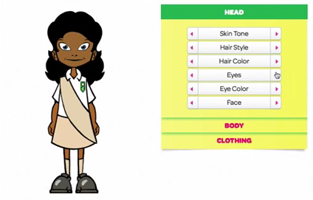
eNuts+ Avatar
Girls create an avatar that looks just like them
There are options for customizing everything: skin, hair, eyes, face, clothes, and shoes
Girls earn a custom girl avatar patch when they sell $175 in nut products!
2015 Fall Product Program

Slide 15
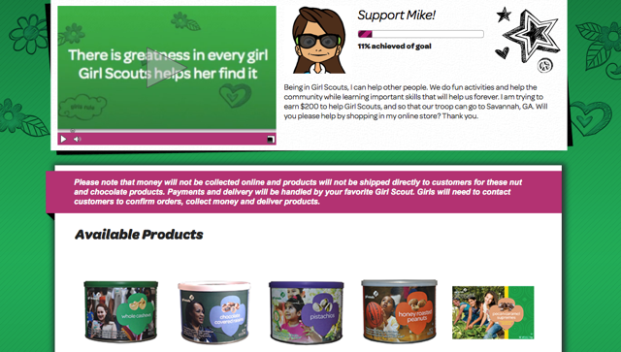
Customer Landing Page
2015 Fall Product Program

Slide 16
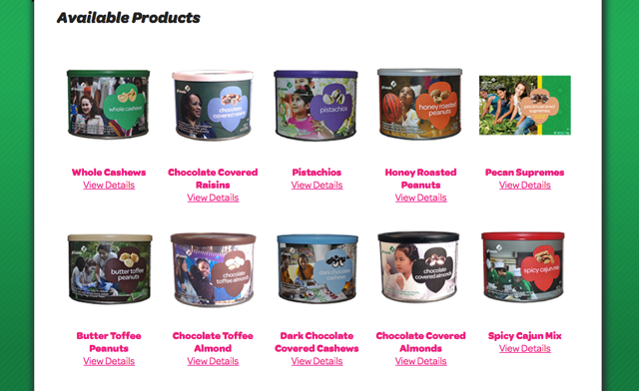
Available Products
2015 Fall Product Program

Slide 17
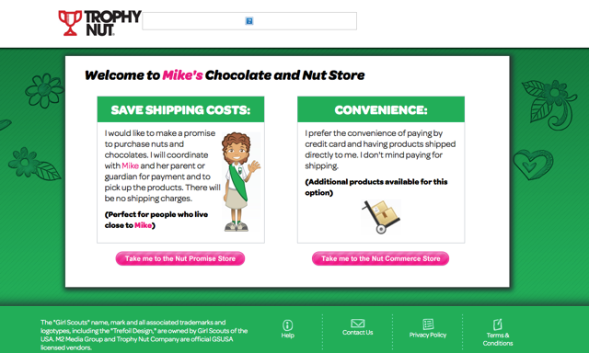
Promise or Shipping Options
Girl Delivery option expires at the end of Order Taking October 16, 9 PM
2015 Fall Product Program

Slide 18
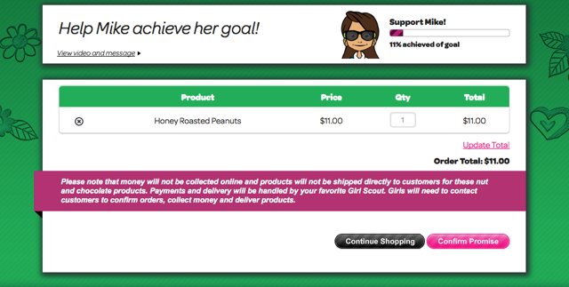
Promise Confirmation
2015 Fall Product Program

Slide 19
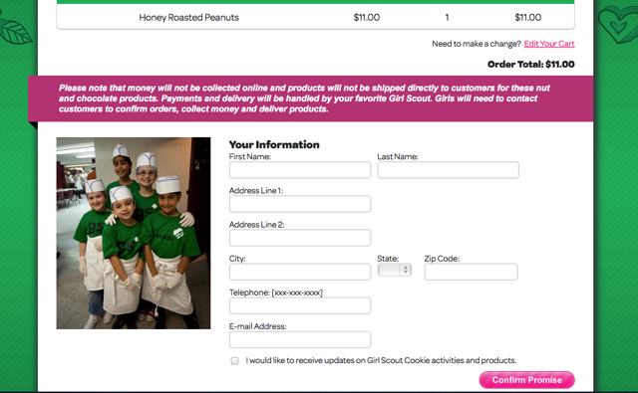
Promise Fulfillment Information
System explains what their choice is
2015 Fall Product Program

Slide 20
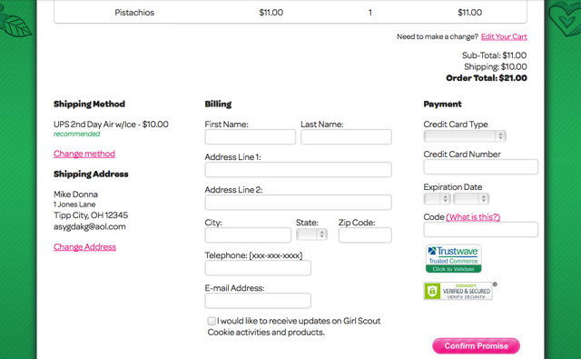
Shipping Information
If no chocolate items, you can downgrade shipping method to save $$$
2015 Fall Product Program

Slide 21
Trophy Nut Products p. 11
15 products plus GOC on the order card
Four price points: $5, $7, $9 and $10
One new product at new $10 price point!
Sweet –n-Crunchy Trail Mix
20 individual packs
2015 Fall Product Program

Slide 22
Products & Pricing
Dark Chocolate Sea Salt Caramels
Peanut Butter Monkeys
Each troop receives one sample box
$5/box
2015 Fall Product Program

Slide 23
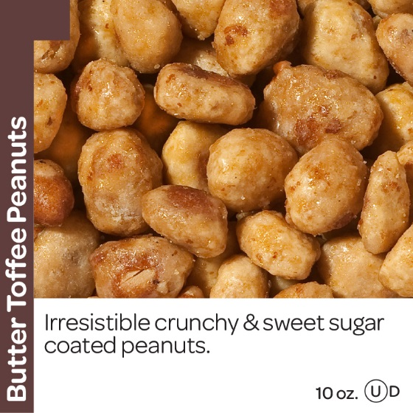
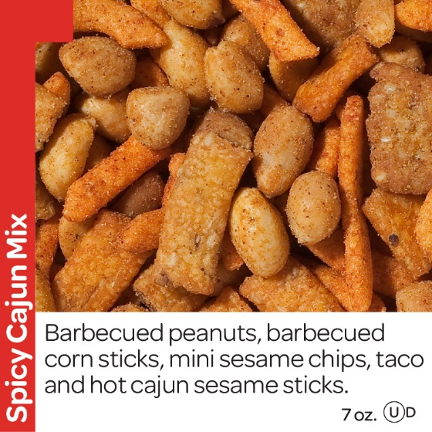
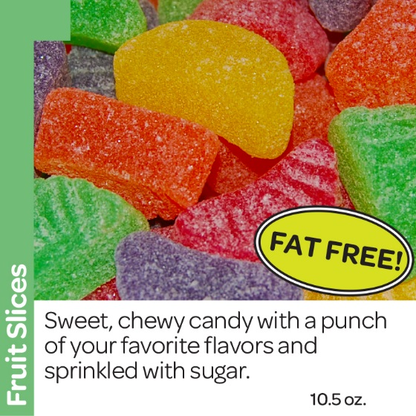
Products & Pricing
Spicy Cajun Mix
Fruit Slices
Butter Toffee Peanuts
#1 Seller!
$5/can
2015 Fall Product Program

Slide 24
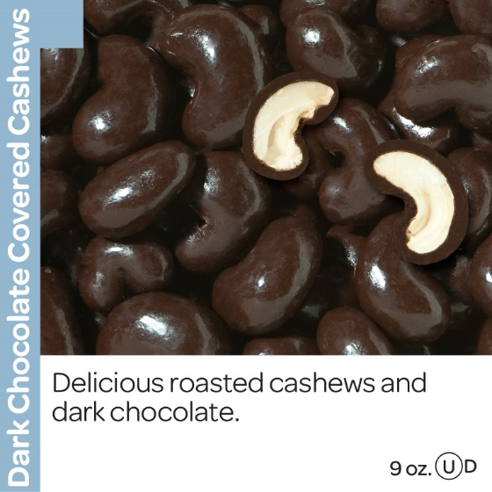
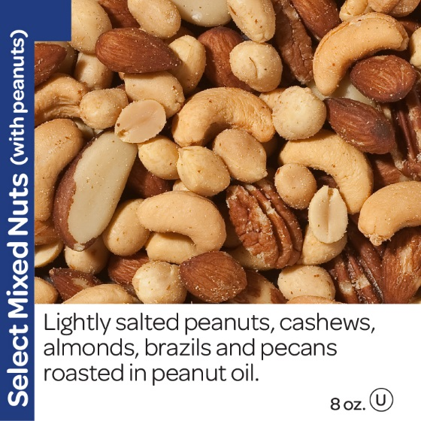
Products & Pricing
Dark Chocolate Cashews
Select
Mixed Nuts
Cranberry
Trail Mix
$7/can
2015 Fall Product Program

Slide 25
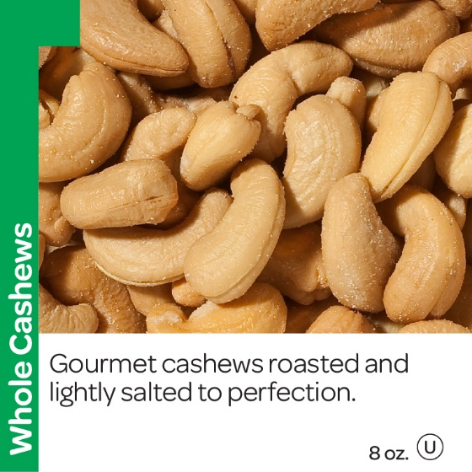
Products & Pricing
Chocolate
Almonds
Whole Cashews
Chocolate Raisins
$7/can
2015 Fall Product Program

Slide 26
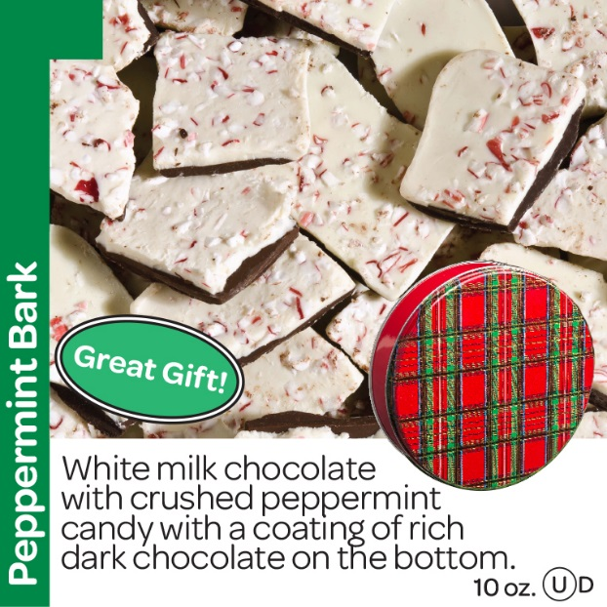
Products & Pricing
Peppermint Bark
Pecan Supremes
Mint Trefoils
$9/tin
2015 Fall Product Program

Slide 27
Products & Pricing
Sweet-n-Crunchy Trail Mix
New!
$10/box
2015 Fall Product Program

Slide 28
Planning Your Nut Order p. 12
www.girlscoutsnutsandchocolates/admin
Enter quantities by
Initial Booth Order (products can be transferred and you can order extras for the troop) Recommended
or by girl (cannot be edited)
Add girl orders together to make one troop order
Orders do not have to be in whole cases, but you might want to round up if you need 9 or more of any one product
This is the only order, so order a little extra, especially the most popular items
Allocate to girls after your enter the troop order
2015 Fall Product Program

Slide 29
Placing an Order in TNOS (Initial Booth Order)
This is an important choice. Preserve your ability to move product!
Enter the troop’s entire order as a whole.
2015 Fall Product Program

Slide 30
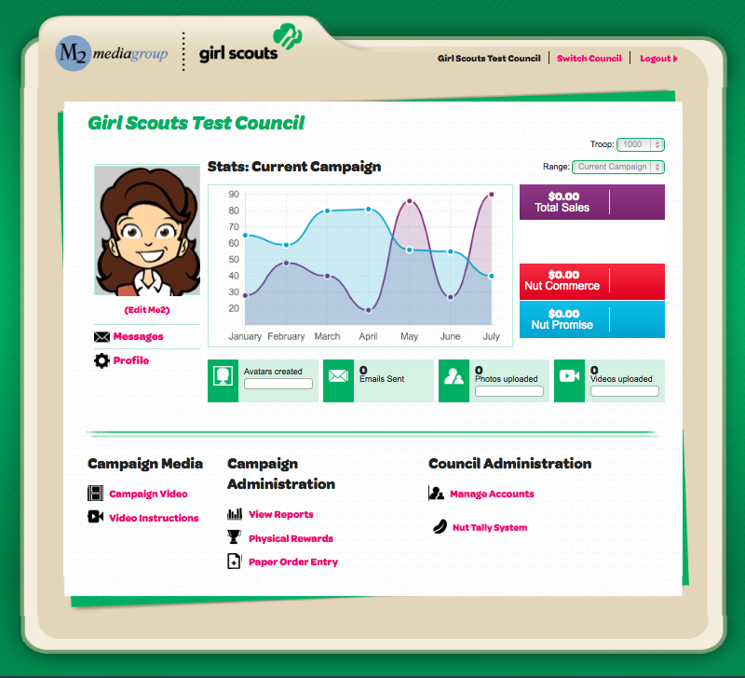
Placing an Order in eNuts+ (by Girl)
Enter girl orders
2015 Fall Product Program

Slide 31
Allocating Girl Orders in TNOS
Here is the detail for what can be allocated to girls.
2015 Fall Product Program

Slide 32
Selling Guidelines
p. 12
Girls may do walkabouts (door-to-door sales) and lemonade stands (a booth at a private residence where the girl resides) Nov. 1-8.
No booths on commercial property.
Troops must not solicit booths; your SU is working on cookie booths right now.
No cupboards. Troops that do not place an order on time CANNOT expect to get product later.
Troops should order extra product if they think girls will continue to sell.
2015 Fall Product Program

Slide 33
QSP Magazine Subscriptions p. 13
Parents visit www.girlscoutsla.org and click on the QSP Online Program button
Girls set up their accounts, send out emails and customize their giraffe.
Girls earn the customized giraffe patch for $175 in magazine sales!
QSP has the best customer service in the business! Call their 800 number for any issues.
2015 Fall Product Program

Slide 34
Magazines
Food Network, HGTV & Dr. Oz in Fall 2015
Magazine Gift Card options
$20, $25 and $50
Donation option: Girls Helping Girls

Slide 35
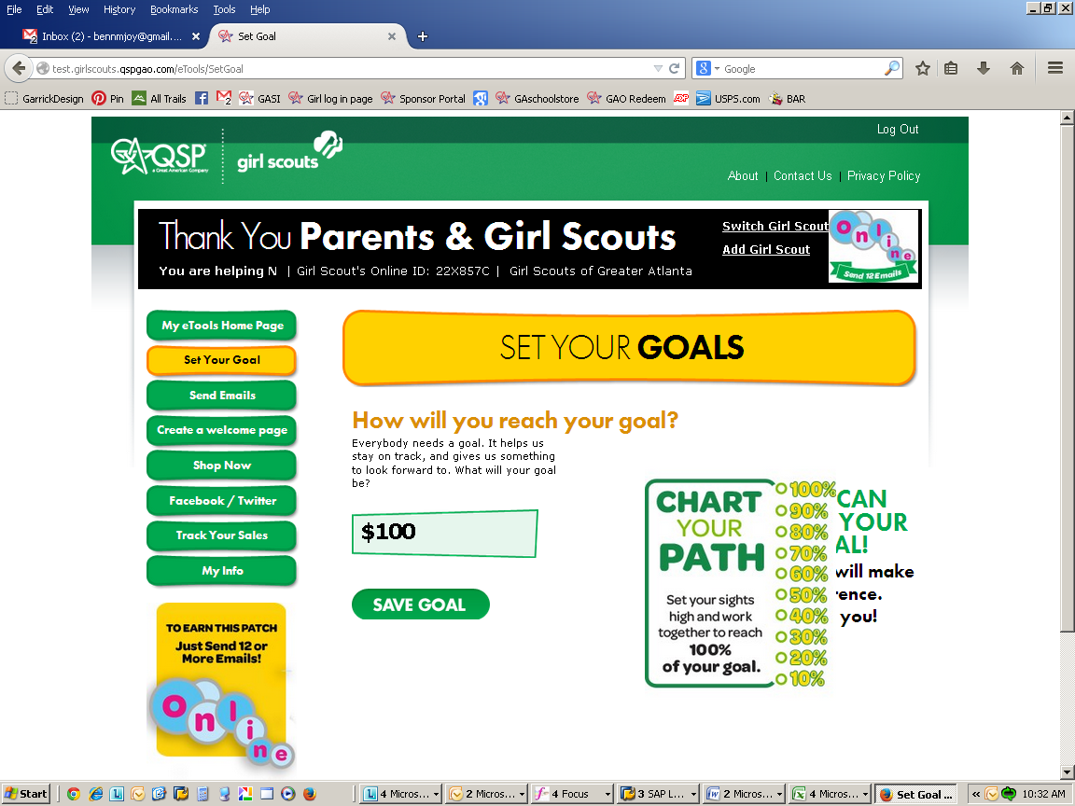
How to Participate
Online Ordering
Participants register or login (returning girls) at http://girlscouts.qspgao.com/greaterla
Click Compose Message
Set Goal for customers to see
Customize message
For best results, upload your picture or create a video
2015 Fall Product Program

Slide 36
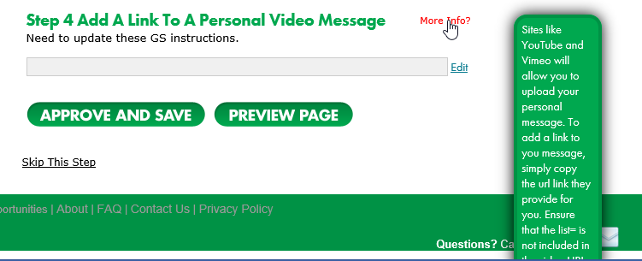
Troop/Girl Custom Sales Videos
New way to customize the message.
Shoot video
Upload on hosting site
Copy URL and Paste here
https://www.youtube.com/watch?v=AmHMZ6xuC6c
Prospects are 72% More Likely to purchase a product or service when video or picture is used.
Video decreases the time it takes a viewer to make a buying decision by over 70%
(Wharton School of Business)

Slide 37
Sending Emails to Family & Friends
Click Manage Contacts
Upload or manually enter addresses
Previously entered email addresses accessible
Order history from Fall 2014 available
Encourage girls to send out emails right away!
Let time work for you.
Customers need to respond by November 8
2015 Fall Product Program

Slide 38
Text & Share Feature
Click Text & Share
Create your text message
Girl/parent sends verification text to girl’s/parent’s phone
Once verified, active link received to be forwarded to friends and family

Slide 39
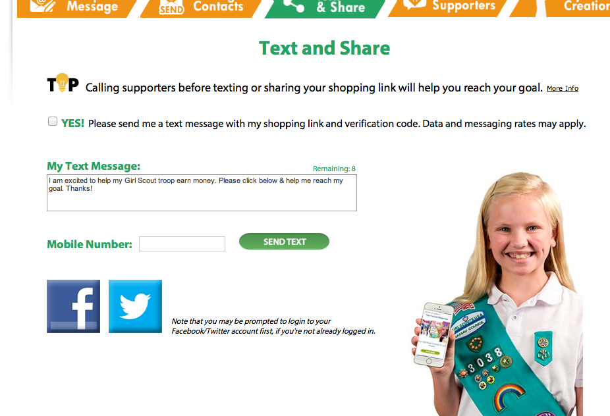
Facebook & Twitter
Opportunity to reach broader network of family and friends!

Slide 40
Spreading the Word
Include assigned Girl Online ID OR name & troop number on each “Spread the Word” card.
Distribute “Spread the Word” cards to customers who can go online to girlscouts.qspgao.com and order magazines.
Just give’em the card… Works every time!
Ava Pettit
75748

Slide 41
MyPatchCreation™
Girls who reach $175 in online magazine sales earn their own personalized patch, with her name, date and MyCreationTM image
Email automatically sent to registered email address link to create/edit patch.
Parent provides shipping address
Patch is shipped directly to the girl in 4 to 6 weeks

Slide 42
Troop Proceeds
p. 14
Troops earn 25% of the purchase price on nut products, including all eNuts+ items.
Troops earn 20% of the subscription price of magazines.
These are highest troop proceeds in the country.
Fall Product is about funding the troop until cookies.
2015 Fall Product Program

Slide 43
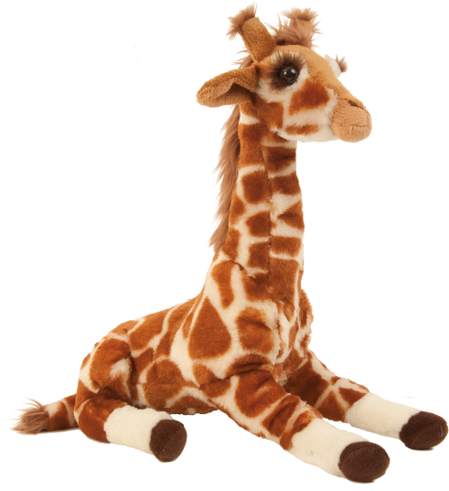
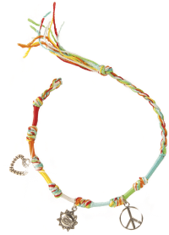
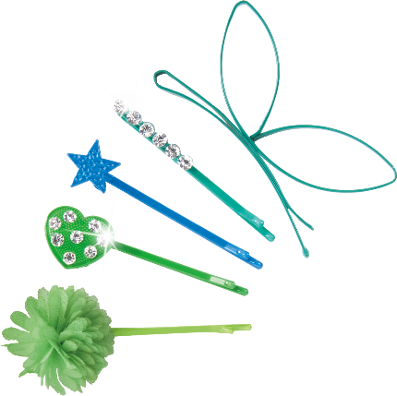
Rewards p. 15
Rewards are “unitized” whether girls sell nuts or magazines
Troop reward: Average 45 units per girl to earn a movie ticket for each girl and two adults
Participation patch and rocker charms
Giraffe plush
Nail art kit
Tie-dye bracelet with charms
Decorative hair pins
2015 Fall Product Program

Slide 44
Rewards – New Customized Patches!
Girls earn avatar patch for selling $175 in nut products
Girls earn giraffe patch for selling $175 in magazines
2015 Fall Product Program

Slide 45
Gift of Caring p. 16
Customers purchase nut products to donate
Girls need to sell this concept
Ideal for customers who do not want a product, but do want to support their favorite Girl Scout
“Virtual” donation—customers and girls do not order or handle the product
GOC donations count towards rewards like all sales
Can only be recorded during Initial Order phase (through Oct. 16)
2015 Fall Product Program

Slide 46
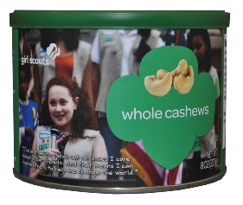
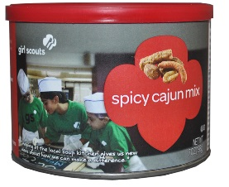
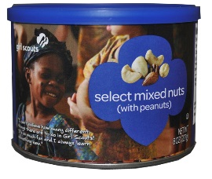
Trophy Nut Order Pick-up p. 17
October 30 – November 1
Be on time!
Count, count, & recount. Get a receipt to confirm your delivery.
Take orders straight home
Have parents sign receipts for the girls’ orders
Store product properly. Melted chocolate is not considered damaged.
2015 Fall Product Program

Slide 47
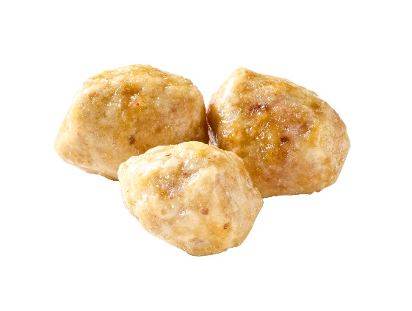
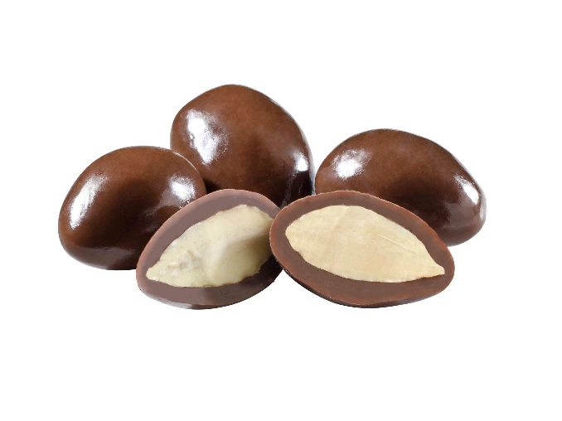
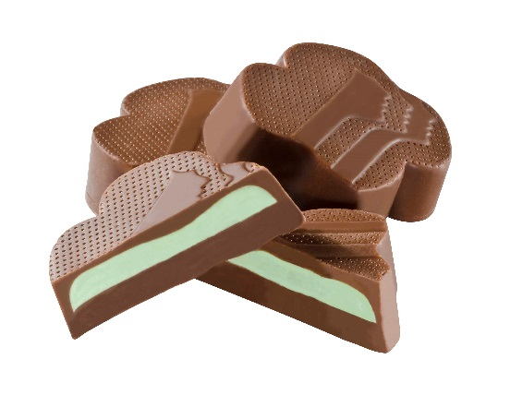
Returns, Exchanges & Transfers p. 18
No returns
Replace damaged product at a service center
No exchanges
SU can facilitate troop-to-troop transfers as the only method to change a troop’s order
TNOS only allows transfers of “Initial Booth Order” product
2015 Fall Product Program

Slide 48
Cash Handling p. 18
Payment is collected only when product is delivered
Troops may use their CC reader from prior sales
Receipt every transaction
Record girl payments in TNOS
Understand girl responsibility vs. troop responsibility
$300 maximum debt limit
Troops deposit money promptly and frequently
One ACH debit, November 20
Troops will be “pinged” $1 via ACH, which will be credited to the troop as a payment
ACH failures will result in $25 administrative fee
2015 Fall Product Program

Slide 49
Tracking Sales
p. 20
Enter in TNOS:
Bank information
Girl allocations
Girl payments to troop
Verify troop transfers entered for you by SUFPC
Verify magazine orders after November 9
Enter in eNuts+:
Add girls as needed
Girl orders and Gift of Caring
2015 Fall Product Program

Slide 50
Returned Checks/Parent Issues p. 21
Contact check’s maker as soon as possible to try to resubmit check
If necessary, forward original or bank copy to council within 3 business days
Submit Discrepancy Reports at end of program if parents owe money
Follow detailed guidelines from your Troop Guide
2015 Fall Product Program

Slide 51
Crisis Management p. 22
If you receive a serious product complaint, call the Customer Care Hotline:
213-213-0123
“Contain” the situation
Gather relevant information
Fill out an Incident Report
Refer all media inquiries to the council
2015 Fall Product Program

Slide 52
Wrap-up
p. 23
Finish strong!
Allocate all products – down to zero
Verify Troop-to-Troop transfers so you pay council the exact right amount
Record Gift of Caring donations
Verify magazine subscriptions in TNOS
Deposit money no later than Nov. 16
Turn in Discrepancy Reports as necessary
Celebrate your girls’ successes!
Rewards should be ready in January
2015 Fall Product Program

Slide 53
Our council’s success is due to your efforts…

