Slide 1








2017 Cookie Program
Troop Cookie Chair Training
Theme, Mascot, & Colors for 2017
Meet Olita!!!

Slide 2



Thank You!
Thank you for your time, dedication and contribution to the BIGGEST girl led program of the year.
Because of you, girls learn the 5 Skills:
  Goal setting
  Decision making
  Money management
  People skills
  Business ethics
TCCs are the ‘lieutenants who make this happen. You support girls and parents so that they can succeed in reaching their goals.
Remember WHY we do this.

Slide 3

ACH
Service Unit Team
We have a team to get the job done!
Service Unit Cookie Program Chair (SUCPC)
Boothing Chair
Delivery Chair
Cupboard Manager
Rewards Chair
Troop Mentor
Juliette Advisor
SUM

Slide 4
ACH
Troop Cookie Chair (TCC)
This is YOU!
Work with the girls to set goals for service, fun and learning. Remember to help the girls set individual goals, too!
Collect signed permission forms
Collect orders and enter into eBudde
Receive cookies at delivery, count and sign for them
Distribute cookies to girls
Collect funds from parents
Order additional cookies as needed from cupboards
Distribute rewards

Slide 5
Timeline
January
Cookie Kick-offs
Troops’ Starting Inventory Order due
Starting Inventory Order deliveries
GO DAY
February
Cupboards open
Boothing begins
1st ACH Debit
March
Cookie Program ends
Review troop allocations, transfers, GOC and rewards.
Submit SU Rewards
Final ACH Debit
May
Cookie rewards delivered to SURC
Club 500 and Elite 1000 events
June
1500+, 2000+, and 3000+ events

Slide 6
January
Sun | Mon | Tues | Wed | Thurs | Fri | Sat
1 | 2 | 3 | 4 | 5 | 6 Booth Scheduler Round 1 | 7 SIO due 11:30pm
8 | 9 | 10 | 11 | 12 Booth Scheduler Round 2 | 13 | 14
15 | 16 Booth Scheduler Round 3 | 17 | 18 Booth Scheduler Round 4 | 19 | 20 | 21
22 | 23 | 24 | 25 | 26 | 27 | 28
29 GO Day | 30 | 31
SIO Deliveries
Direct Sales by Girls, Jan 29 -Feb 9

Slide 7
ACH
February
Sun | Mon | Tues | Wed | Thurs | Fri | Sat
 |  |  | 1 Booth Scheduler Round 5 | 2 Cupboards Begin To Open | 3 | 4
5 Super Bowl | 6 | 7 | 8 | 9 | 10 Boothing Begins | 11
12 | 13 | 14 | 15 | 16 | 17 | 18
19 | 20 | 21 | 22 | 23 | ACH Debit #1 | 25
26 | 27 | 28
Direct Sales by Girls, Jan 29 -Feb 9
SIO Returns
Direct Sales by Girls, Jan 29 -Feb 9
Even Exchanges; cases
Even Exchanges; whole cases
Exchanges
Even Exchanges; to the box
Nat’l Cookie Weekend
Even Exchanges; to the box

Slide 8
ACH
March
Sun | Mon | Tues | Wed | Thurs | Fri | Sat
 |  |  | 1 | 2 | 3 | 4
5 | 6 | 7 | 8 | 9 | 10 | 11
12 SALE ENDS | 13 | 14 Consignment Returns | 15 | 16 | 17 Troop Alloc, T2T, GOC | 18
19 | 20 | 21 | 22 | 23 | 24 | 25
26 | 27 | 28 | 29 | 30 | 31 ACH Debit #2
Exchanges
Consignments
Consign

Slide 9









Cookie Varieties
$5 / Box

Slide 10

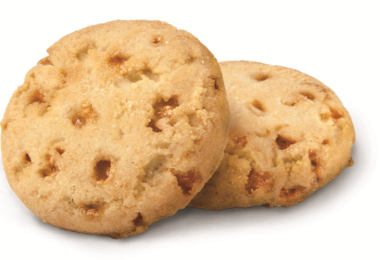

Toffee-Tastic
Specialty Cookie: Gluten Free
Council ordered 7,500 cases
Guaranteed troop SIO order, no limit
Balance of cases in cupboards, ONLY if SIO is less than 7,500 cases
Retail price is $6/box
  High cost of ingredients/production

Slide 11

S’mores
Specialty Cookie
  Made with natural flavors / Non-GMO
  Whole Foods compliant
  5 outdoor badges embossed on cookies
Council ordered 24,000 cases
Guaranteed troop SIO order, no limit
Balance of cases in cupboards, ONLY if SIO is less than 24,000 cases
This year’s Troop Cookie!
  National Embargo – no social media, no pictures, no discussions with media
Retail price is $6/box
  High cost of ingredients/production

Slide 12

Gift of Caring (GOC)
Our 9th variety of cookies!
A “virtual” box is sold for $5 and GSGLA donates to one of our 5 GOC partners.
Need to train girls/parents how to sell GOC.
Sales happen so fast, make sure GOC does not get forgotten - it’s important to ASK for support.
Our partners depend on our girls!
Set a troop and/or per girl GOC Goal to encourage participation.
Set a SU participation goal!
Girls can earn Special GOC Rewards!
Official Gift of Caring Sponsor

Slide 13
Gift of Caring (GOC)
2013 2014 2015 2016
2016 GOC girl participation was at 32%.
Means 68% didn’t participate in GOC sales.
2,500 less girls than participated in 2014.
2016: 99,173 GOC boxes / 8,989 participating girls =
11.03 PGAGOC

Slide 14





Gift of Caring (GOC) Partners

Slide 15

ACH
The 5 Skills for Girls
  Goal Setting
  Decision Making
  Money Management
  People Skills
  Business Ethics
  The Cookie Program teaches girls real-life skills.

Slide 16

ACH
Cookies 4 a Change
Bring service ideas to life!
Discover
Connect
Take Action
Allocate a percentage of proceeds to a charity of their choice
Set of goal of feeding 10 animals at a local shelter
Fund and plant a garden at the local senior center

Slide 17
ACH
Troop Proceeds
$.95/box
27 boxes = GSUSA membership dues for one girl
Cadette, Senior and Ambassador troops may opt out of rewards for an extra $.10/box
Opt-out troops receive SIO rewards!
Girls in opt-out troops receive all patches and Club 500 and Elite 1000 events (if earned)

Slide 18
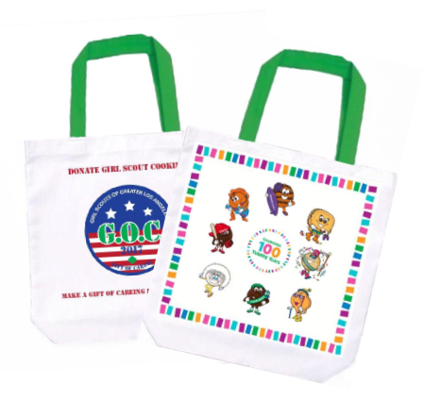

ACH
2017 Rewards
Starting Inventory Rewards – 75%
Tote Bag
Troop Leader Vintage Cookie Tray

Slide 19




ACH
Participation & Special Patch Rewards
OR
12 - 23
Participation Patch
24+
Participation Patch
2016 Fall / 2017 Cookie Combo Patch
Girls must have met the
2016 Fall Program criteria AND
Sell 250+ boxes of cookies
Cookie Club Patch
24+ valid emails sent via Cookie Club

Slide 20
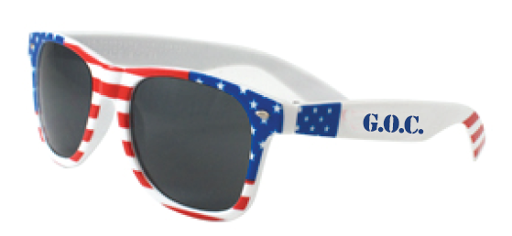


ACH
2017 Gift of Caring Rewards
20 GOC
Sunglasses
10 GOC
Patch
30 GOC
Pen

Slide 21



ACH
2017 Rewards Events
Club 500 is May 20, 2017
Six Flags Hurricane Harbor
Elite 1000 is May 6, 2017
Disney’s Yes Program
Disney Resort

Slide 22


ACH
2017 Rewards Events
1500+
S’More Adventure Weekend June 10-11, 2017
Camp Osito Rancho
2000+
Limo Ride & Lunch with Lise Luttgens, CEO
June 21, 2017

Slide 23


ACH
2017 Reward Event Option
OR
3000+
38mm Apple Sports Watch
3000+
VIP Experience at Universal Studios
June 17, 2017

Slide 24


ACH
Troop PGA Rewards
$15 Cookie Dough
Troop PGA 240+
Hoodie Sweatshirt
Troop PGA 320+
Each participating girl plus 2 Troop Leaders
PGA = Per “Selling” Girl Average (NOT registered girls)

Slide 25
ACH
Program Credit - Reward
An optional reward for levels that offer only an event (500+, 1000+, 1500+, and 2000+)
A GSGLA Gift Card will be issued.
Can only be used internally (GSGLA) for:
  Retail In-Store Purchases
  Girl Annual Membership
  GSGLA events
  GSGLA specialty and resident camps
  Destinations
Detailed use and redemption procedures will be provided to recipients.

Slide 26
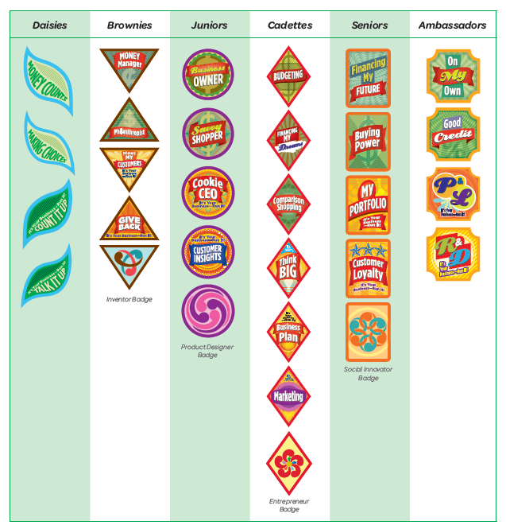

ACH
Cookie Business Curriculum
Girls learn the 5 Skills and earn the Cookie Activity Pin
Cookie Business and Financial Literacy badges help girls hone their skills and gain an understanding of the world of business.

Slide 27

ACH
Best Cookie Season Ever – 5 Steps
Set and share team goals
Set a goal for each girl
Educate families
Sell beyond family and friends
Track progress and celebrate your success

Slide 28
What’s New?
New cookie – S’mores! (replaces Rah-Rah Raisins)
Greater Magazine – Full Cookie Family Guide
  Mailed to all registered girls in October, also available online
High Five Series Books (Daisies – Cadettes)
  Cookie Business and Financial Literacy Badges (available online)
Starting Inventory Order
  Only one level – 75% of 2016
  Opt-out troops eligible for SIO Reward
  Troop Leader SIO Reward
  Orders entered in one lump sum and in case quantity, to be allocated when cookies are delivered
  Girls will be uploaded into eBudde after SIO
Rewards
  New reward events – 1500+, 2000+, and 3000+ boxes
  Rewards Choice Sheet – each girl to complete for reward choices and sizes

Slide 29
Volunteer Feedback – We Hear You!
Girl and Family Training Powerpoint*
Quick Start Guide to Cookies (replaces Family Letter)
Juliette Family Guide*
Script for Selling Girl Scout Cookies*
Pre-Recorded Just in Time Training Modules*
Let’s Chat Webinars – dates to be published
Weekly Communications – targeted mid week for SUCPCs and TCCs
Cupboard Exchanges
  Added 7 additional days for cupboard exchanges
  First portion in whole cases, then at box level
Final ACH Debit
  Added 6 additional days between end of sale and final ACH Debit, for troops to collect funds
*available online

Slide 30
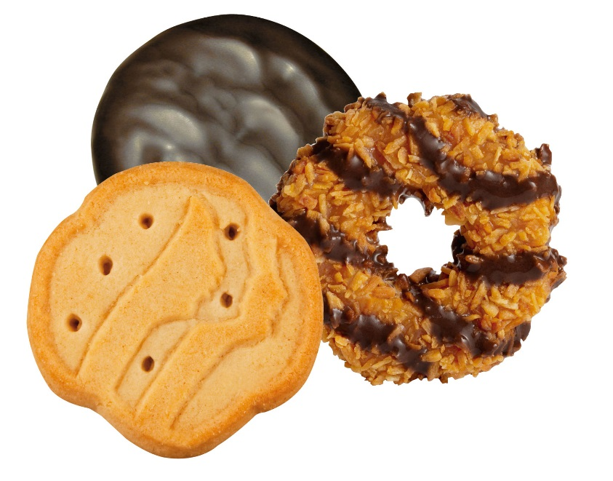
Just-in-Time Training Opportunities
Just in Time training webinars as reminders of important or technical processes.
Topics will include:
Starting Inventory Order
Boothing Scheduler
Allocating to Girls, and more…
  These helpful webinars are:
  10-15 minutes each
  Available on the website
  Located on VIP eTraining, Council section

Slide 31
ACH
Why We Train Troops
Well-trained girls (and parents):
  Manage their money and inventory better.
  Desire leadership and follow your instructions.
  Make fewer mistakes.
  Can “co-train” parents who are not fluent in Cookies.
  Are effective program ambassadors; they sell more because they are confident in their abilities.

Slide 32

ACH
Training Checklist for Family Meeting
Key troop training messages:
  Use the new Girl/Parent Training PowerPoint
  Communication and meeting deadlines is key to just about everything.
  View eBudde materials so you feel confident.
  How to set troop and girl goals:
    Service Project goal for booth pitch.
    Fun/adventure goal.
    Troops need to explain and sell Gift of Caring.
    VIP eTraining does so much of this for you.
      Incorporate it by making a challenge of who brings the most completed quizzes.

Slide 33
ACH
Communication Plan
Train troops and parents on the best way to communicate with you, and how you will communicate with them.
Council will communicate with troops via:
  Greater Cookie Program Family Guide
  CookiEgrams from Olita
  GSGLA Cookie & Nut Friends Facebook page
  Cookie Central, the GSGLA cookie website
  Webinars on VIP eTraining
  Targeted eblasts via eBudde
  Step-by-step instructions

Slide 34
ACH
Communication Plan
Timely and clear communications:
  Are critical to the success of the Cookie Program!
  Helps everyone to be most effective.
Council will send regular/timely email/eBudde reminders and helpful hints to SUCPCs
  Will contain both SUCPC, TCC and Parent information.
  TCCs must check emails daily, for important updates and take action as applicable.
    Forward on (via cut/paste) information directed to Parents.
Send out additional emails to parents/girls with service unit/troop specific information and overall status of how the troop is doing, fun challenges, etc.

Slide 35

ACH
Cookie Captains
Looking for girl Cookie Captains to help produce our SU Cookie Kick-Off.
Older girls who are experienced cookie sellers.
Mentor younger girls.
  Assist troops to earn cookie badges using the High Five Series books.
Run stations at your Cookie Kick-off.
Can be paired with new troops to share their expertise throughout the cookie season.
Talk to your SUCPC about your participation!

Slide 36
ACH
Sales Materials
For each REGISTERED GIRL
Distribute at TCC Training:
Quick Start Guide
Money Envelope
Reward Choices document
Distribute at Cookie Delivery:
Girl Order Card
NOTE: Girl Order Cards are NOT available from Service Centers. Troops need to get them from their service unit.
For each TROOP
Distribute at TCC Training:
Troop Guide
Jumbo Envelope
Receipt Book(s)
Gift of Caring Receipts
Distribute at Cookie Delivery:
Marketing Kit

Slide 37

ACH
Rules and Consequences
Troops, girls and parents must follow all of the rules and policies of the Cookie Program.
SUCPCs can apply consequences.
Possible consequences:
loss of proceeds, and/or
loss of boothing opportunities, and/or
loss of rewards
Our goal is to inspire compliance with the rules, and equity for all girls.

Slide 38
ACH
eBudde Setup
eBudde is the system used to manage
your Cookie Program.
SUCPCs give TCCs access to eBudde between Dec 5 and Jan 2 AFTER:
  TCC Agreement, ACH Debit Authorization and a troop check (eForms) are confirmed submitted.
  TCCs are fully trained (for this years sale) by SUCPC.
TCCs verify login as soon as possible and update password – plan ahead for Booth Scheduler Round 1, Jan 6, and SIO is due Jan 7
  Notify SUCPC of unsuccessful system access.
TCCs add other troop volunteers and assign a role.

Slide 39
ACH
eBudde Setup
Troop numbers will be transferred to eBudde before Dec 1, from last year’s sale.
  SUCPC will add any new troops and can delete disbanded troops.
Girls will be added to eBudde week of Jan 9, after the SIO is submitted.
Council will import troop banking information during the week of Jan 9 (from ACH Authorizations received by Jan 2).
  TCC/Troops submitting their ACH Authorization after Jan 2 will have to manually add banking information to eBudde.
Recorded eBudde webinars will be on the website.

Slide 40
ACH
Booth Scheduler
Each round is open for 24 hours, then closed for 24 hours.
eBudde limits the number of choices each round.
First round is limited to home SU. Violators may be deleted without notice.
Sign-ups are cumulative.
One round BEFORE SIO is due
Round # | Start Time |  | # Choices | End Time
1 | January 6 | 6:30 PM | 3 | January 7 | 6:30 PM
2 | January 12 | 6:30 PM | +2 | January 13 | 6:30 PM
3 | January 16 | 6:30 PM | +4 | January 17 | 6:30 PM
4 | January 18 | 6:30 PM | +11 | January 19 | 6:30 PM
5 | February 1 | 6:30 PM | Unlimited | N/A | N/A

Slide 41
ACH
Scheduling Booths
Shifts are generally 2-3 hours with shorter shifts on the first weekend.
All boothing locations must be entered into eBudde.
Troops can only booth at sites listed in the Booth Scheduler.
Troops are to cancel shifts they will not use.
Hoarding booths (taking more shifts than a troop can support, based on # of girls) is NOT allowed.
  SUBC will regularly monitor eBudde and work with troop to reduce, as needed.
  SUBC has the right to reduce sites for non-responsive troops.
Troops may request “special sites” directly in eBudde.

Slide 42
ACH
Direct Sale Dynamics
Sale begins with “Cookies in Hand,” requiring more inventory on hand!
Customers buy more for instantaneous gratification
Girls need access to cookies at all times.
Don’t know what you will need, when
Envision what a walkabout will look like.
Example: 10 Thin Mints won’t work
Cupboards WILL BE BUSY.
Save time—order enough cookies up front (note: cupboards don’t start opening until Feb 2!).
Have faith in your girls.
You will sell lots of cookies

Slide 43
ACH
Starting Inventory Order (SIO)
Troops need to place an SIO by Jan 7 for girls to start selling on Go Day (Jan 29).
SIO should cover troops for 2 weeks plus opening booth weekend.
Recommend 75% of total 2016 troop sales.
Cupboards “begin to open” on Thursday, after GO Day; DO NOT rely on the cupboards for SIO.
Girls need cookies in hand on Go Day.
Don’t get stuck in the long cupboard lines, submit an SIO.

Slide 44
ACH
Starting Inventory Order (SIO)
Troops should rely heavily on
the excel SIO Worksheet
They can be confident in their order because:
  75% of our volunteers stated they had the right amount, or needed more cookies last year.
  ACH Debit #1 ($2/SIO box) is 2 weeks after boothing starts.
  SIO return policy - up to 10 unopened cases.
75% “feels” like a lot, although this is typically what is sold within the first 2 weeks.
Work with parents and girls to set goals and provide assurance that the troop can take on the recommended volume with confidence.

Slide 45
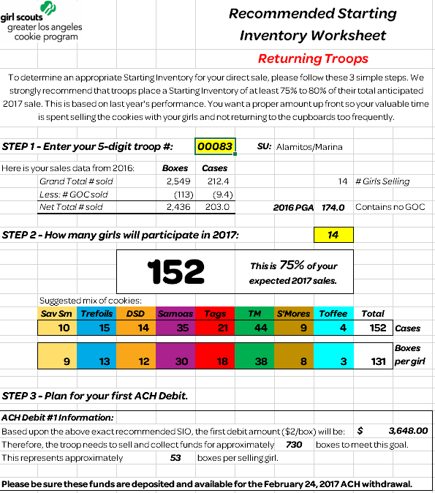
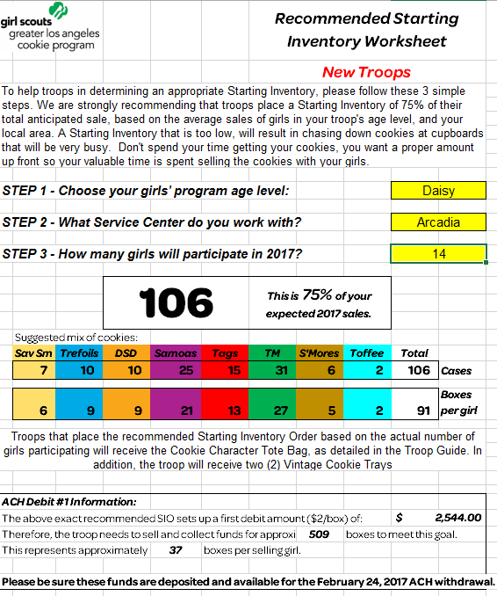
ACH
Starting Inventory Order (SIO)
Returning Troops
New Troops
Excludes GOC.
Returning troops based 2016 total troop sales.
New troops based on 2016 troop sales for level/area.
Provides details, including first ACH Debit amount due.

Slide 46
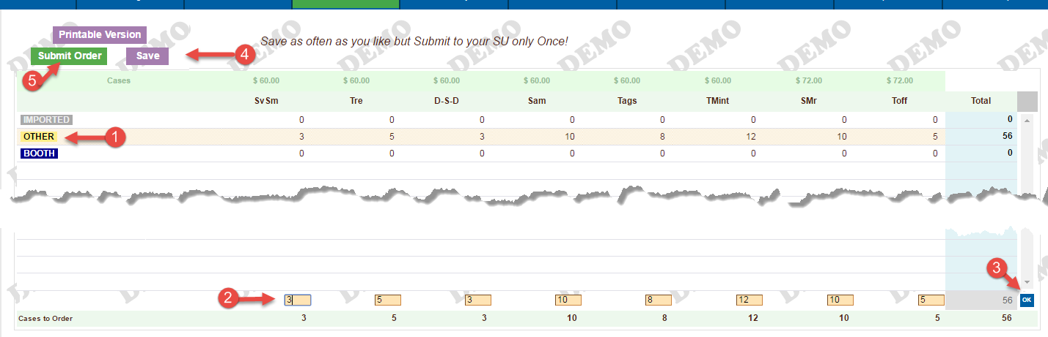
ACH
eBudde – Troop SIO Entry
The order will be entered as a troop, not per individual girl.
From the INITIAL ORDER Tab click on OTHER to input the total number of whole cases per variety (these are the totals from your SIO Worksheet).
Click the OK and SAVE buttons.
Don’t forget to click SUBMIT when you sure your order is complete (note deadline is 11:30pm on January 7).

Slide 47
ACH
Review & Submit Troop Orders
Submitting SIO made easy:
TCCs enter in the cookie order in whole cases by flavor.
Remember: No limit on Toffee-tastic and S’mores.
  May not be available in the cupboards!
TCCs enter the SIO reward quantities - number of girls MUST match SIO worksheet girl count.
Troops SUBMIT their SIO order & SIO rewards by
11:30 p.m. on Jan 7.

Slide 48
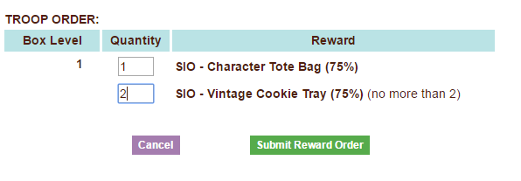
ACH
Submit Troop SIO Reward
From the REWARDS Tab click FILL OUT next to Initial Reward Order
If troops ordered the recommended number of cookies, enter the number of rewards needed for your girls selling. This number MUST correspond to the number of girls used to calculate the 75% level.
Click SUBMIT and OK to submit your troop’s initial reward order
  Once the girl rewards are submitted, NO changes can be made to this field.
  The Number of SIO rewards will not change, even if the number of selling girls increases during the sale.

Slide 49
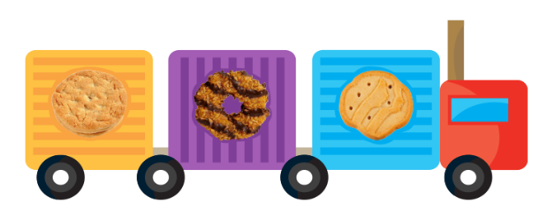
ACH
Starting Inventory Order Delivery
January 26 – 28
Troops select a delivery time working with SUCPC.
Be on time for exact pick up time.
Bring enough vehicles to carry your entire order.
Deliveries will happen rain or shine! Be prepared!

Slide 50

ACH
Safety Around Cookies
Whether at cookie pick-ups, delivering cases to girls and/or booth sites, helping girls sell, or simply moving cookies around in your own home:
Know who is in charge of the location.
Understand your role – ask for clarification, if needed.
Be aware of your surroundings – watch for trip hazards, areas you can bump into, strangers, or unusual behavior of any type.
Remove or report unsafe conditions immediately.
Don’t take on more than you are physically able to do.
Use safe lifting, carting and packing techniques.
Keep clear aisles, pathways and driveways.
Call 911 or ICE-GSGLA if an emergency needs more response than you can handle.

Slide 51
ACH
Girl Order Card
Girls receive at SIO delivery, not training.
Girls can track customer orders & use for call backs.
Contains pricing, cookie types and nutrition facts.
Rewards displayed on the back of the card.

Slide 52
ACH
Selling Girl Scout Cookies
Girls may sell cookies via email, social media
No Craigslist, or Amazon sales
Door-to-Door / Residential Walkabouts
Residential Lemonade Stands at the property where the girl resides starting on Go Day
Telephone friends, family and former customers
Parents’ workplace

Slide 53
ACH
Safety
Safety is first and foremost! It is vitally important for girls & volunteers to remain safe.
Ensure parents and volunteers are following all documented safety rules found in:
  Greater Cookie Family Guide
  Troop Cookie Chair Guide
  Safety Activity Checkpoints
  Volunteer Essentials
  Posted materials

Slide 54
ACH
Boothing Procedures
Troops need to adhere to all boothing policies as outlined in the Greater Cookie Family Guide and Troop Guide, including (but not limited to):
Adult/Girl ratios (by girl level)
1 Girl / 1 Parent Policy: ONLY Cadettes and above (2/24 – 3/12)
Appearance and Conduct
Conflict resolution
Be ready to leave a booth right at the end of the scheduled shift; take trash (do NOT leave in a trash can)
Ensure parents and girls know:
  What to bring to a booth
  How to set up a booth to appeal to a customer
    Suggest that troops practice a booth

Slide 55
ACH
Boothing Procedures
  Special Booths
  Unique opportunities
  Must be approved by SUCPC
  Enter in eBudde
  Drive-through Booths
  Safety first!
  Bring extra adults
  Must be approved by SUCPC
  Enter in eBudde as a Special Booth

Slide 56

ACH
Accepting Credit Cards
Accepting credit cards:
Helps focus on the multiple-purchase customer and increased sales.
Is an easy and useful tool:
Customers not limited to the cash in their pocket.
Customers purchase more with a card.
Credit cards can increase PGA sales by 25 boxes.
Additional payment source - if the troop prefers to not accept checks.
Troops can purchase a credit card reader(s) to attach to smartphones.
Credit card readers must be linked to the troop bank account.
Troops absorb credit card processing fee (usually under 3%) and can NOT up-charge the customer.

Slide 57

ACH
Corporate Booths
High-rises in Downtown, Long Beach, Woodland Hills, Burbank and the Westside.
Application due Jan 13.
Preference given to Cadette and above.
Parents cannot take the site, council reserves.
Cookies may be delivered to booth site, depending on the site’s ability to store them.
Unsold cookies may be returned; troop’s choice.

Slide 58
ACH
Cupboard Guidelines
Cupboards begin to open Thursday, Feb 2
  See eBudde Cupboard Calendar for complete schedule
Troops may pick up from any cupboard.
Place pending orders 24-48 hours in advance.
Troop representatives picking up cookies must be listed in eBudde. Know your PASSWORD.
There are specific dates and requirements for returns, exchanges and consignments.
Damaged cookies may be exchanged at any cupboard, anytime cupboard is open (melted product is not damaged product).

Slide 59
ACH
SIO Return Policy
“Insurance policy” from the SIO Order
Troops may return up to 10 whole cases.
Feb. 7 – 9 only, at designed cupboards.
Troop is not eligible to return if they have added to their inventory, via:
Cupboard pickups
T2T transfers
This is meant to relieve anxiety over taking on the recommended 75% SIO.

Slide 60
ACH
Cupboard Consignment Process
Troops can check out up to 10 cases of cookies on consignment from designated cupboards – March 6 - 12.
Encourages troops to continue to sell the last week.
Decreases risk of having excess inventory.
Troops complete the Consignment Inventory Form.
  Detailed procedures are located on this form.
  Can ONLY have one OPEN consignment at a time.
Consignment returns MUST be returned to the original cupboard, no later than Mar 14.
  Check cupboard schedule for dates/times.
Troops should work with the SUCPC to do troop to troop transfers before consignments.

Slide 61
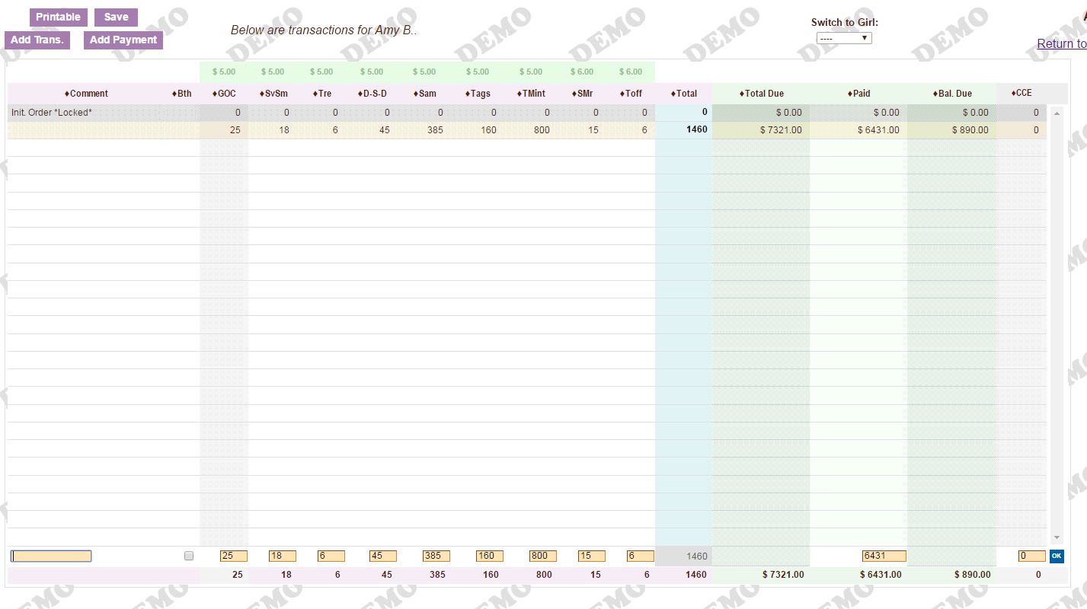
ACH
Allocating Cookies and Payments
Record all girl orders and payments on the Girl Orders tab in eBudde

Slide 62
ACH
Inventory Management
Troops MUST balance their inventory of cookies on hand, on a regular basis.
  Daily update eBudde with girl orders and payments.
  Regularly count the number of boxes/cases on hand.
  Compare inventory on hand to eBudde.
Troops will know if more cookies are needed or has too many and troop to troop transfers are needed.
Will make wrapping up the sale so much easier!
NO troop should end up with excess inventory!

Slide 63
ACH
Parent / Girl Check Ins
“Money Mondays”
Girls and parents should turn in to the troop any monies collected from the prior week’s sales.
Money turned in MUST be in the same form received directly from the customer. Parents are NOT to keep funds received and write a personal check for the balance due.
Money should be collected and deposited into the troop bank account following the “promptly and frequently” mantra.
  Do not deposit one check at a time, or by girl.
“Touch base Tuesdays”
Check in with parents to see what their inventory is before going to the cupboard to pick up additional product.
A troop may take back or exchange inventory that a girl can’t sell to use for boothing. Troops should set a return and exchange policy with parents.
Plan out the upcoming week’s inventory; make good decisions when ordering more cookies.

Slide 64
ACH
Wrap Up
How to submit the Rewards order:
Use the Rewards Choice document received from each girl/parent (do not guess).
Review the Rewards order and select girl/parent requested option for:
Sizes for the 200 T-shirt and 320 PGA Sweatshirt.
500, 1000, 1500 and 2000 choice of recognition or program credit.
Opt out troops with 240 PGA might do better to opt in ($15 cookie dough per girl vs. $.10 per box).
Submit the Rewards Order.

Slide 65
ACH
Rewards Order
SIO Rewards targeted to be delivered on Delivery Day *.
Attempt to deliver end of sale reward items during May.
Program credits will be provided separately.
All other monetary troop rewards will be directly deposited to troop bank accounts.
Packing slips provided. Troops must count and sign for their rewards.
Distribute to your girls promptly.
Rewards not picked up will be returned to council.
* Council estimates the number of each reward item needed in June; actuals are determined after SIO is submitted/by end of March (respectively). If additional rewards need to be ordered, some Sus/troops may experience a delay in receipt. Girl rewards are 1st priority.

Slide 66
ACH
Financial Dates
Troops pay for cookies via two ACH debits
Debit amounts may be adjusted if needed. Troops must contact SUCPC or PSM no later than one week before the debit
Troops must deposit funds to troop bank account in time for funds to be available on debit date
Troops responsible for fees caused by negligence

Slide 67
ACH
Debt Management
Credit Limit Guidelines
  Use caution in how much product is distributed to a parent before collecting money.
  Until comfortable with a parent’s payment patterns, recommend limiting the troop liability to $300 – Confirmed Best Practice.
  Does NOT mean all families can only have 60 boxes at a time!
  Troops MUST collect funds from parents on a regular basis.
  TCCs should set expectations up front (“Money Mondays”).

Slide 68
ACH
Wrap Up
What to look for:
Opt-out troops are Cadettes and above only.
All boxes and GOC have been allocated to girls –including opt-out troops.
Two prices, not all boxes are the same (S’Mores & Toffee-Tastic are $6).
The troop giving product enters T2T transfers.
Do not duplicate to/from transactions
Review payments, submit Discrepancy Reports for family owing balances.
Each troop must submit Rewards, even opt out Can’t opt out of patches, 500, & 1000 events.

Slide 69
ACH
Crisis Management
Notify your SUCPC of complaints with cookies
Media must be handled by GSGLA
Contact 213-213-0123 with media inquiries
Copy your Product Sales Manager on correspondence

Slide 70


ACH
Technology
Cupboard Keeper App
Paperless cupboard transactions
Cookie Locator/Finder App
Customers can find cookie booths in real time
LBB’s Interactive Volunteer Guide
Videos, goal setting plans, inspiration for volunteers
LBB’s Volunteer Blog
Connect with other volunteers, resources, ideas
The Pixie List
thepixielistla.com—Troops can post for Troop-to-Troop transfers (encourage working within SU before posting)

Slide 71

ACH
Cookie Central
The place to go for info:
Link for TCC/ACH eForms
Link to VIP eTraining & eBudde
Forms for Troops & SUs
Cookie Locator & mobile app
Link to Cookie Club
Tips & Activities from LBB
Cookie recipes, Volunteer Guides, & more!
EVERYTHING you need for a successful Cookie Program

Slide 72


ACH
Cookie Club
Features
Online “ASK” Home Page
Electronic Cookie Order Form
“My Promises” Dashboard
Follow-up/Reminder emails
Troop Leader Reporting
Email gets through spam filters
Great way to increase sales!
Digital Order Card
GSGLA opted out for the 2017 sale
Still many “wrinkles;” we’ll re-evaluate for 2018
When implemented by GSGLA, will replace Cookie Club

Slide 73
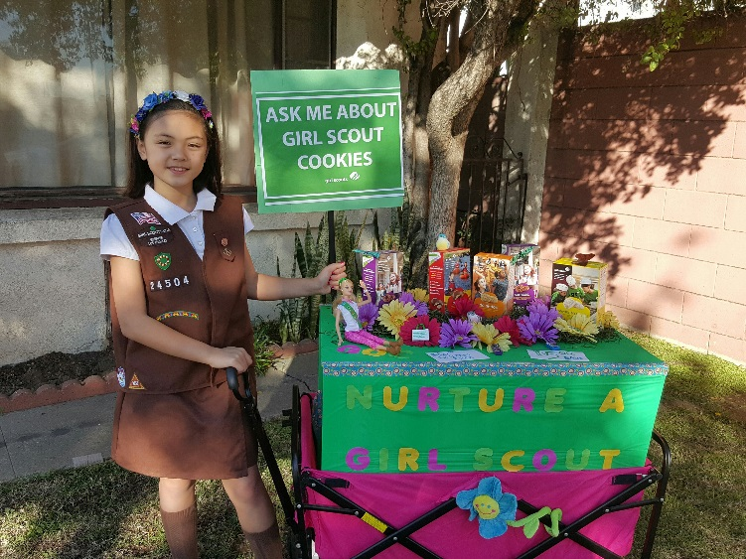
ACH
Cookie Mobile Contest
“Bling Your Mobile Booth”
Direct sale begs for Cookie Mobiles!
Girls need lots of cookies on hand;
Can’t carry them all;
SUs implementing the GRID strategy.
4 themed categories.
Submissions due Feb 11.
Winners earn a pizza party for their troop.

Slide 74

ACH
National GS Cookie Weekend
February 24, 25, & 26
Mostly a national online “social event holiday.”
Several SUs plan serious walkabouts using the GRID technique.
  Create a “grid” map of your SU.
  Organize troop walkabouts.
Expect national media stories.
The “Golden Ticket” promotion to support your booths will be Feb 26 via Twitter.
Troops need a booth reservation for Feb 27 to participate.

Slide 75

ACH
Recruitment
Make Girl Scouts available for everyone.
Share the POWER of GIRL SCOUTS!
Each Service Unit will be provided with fliers from their recruiter to hand out to interested parents before Cookie Booths start.

Slide 76

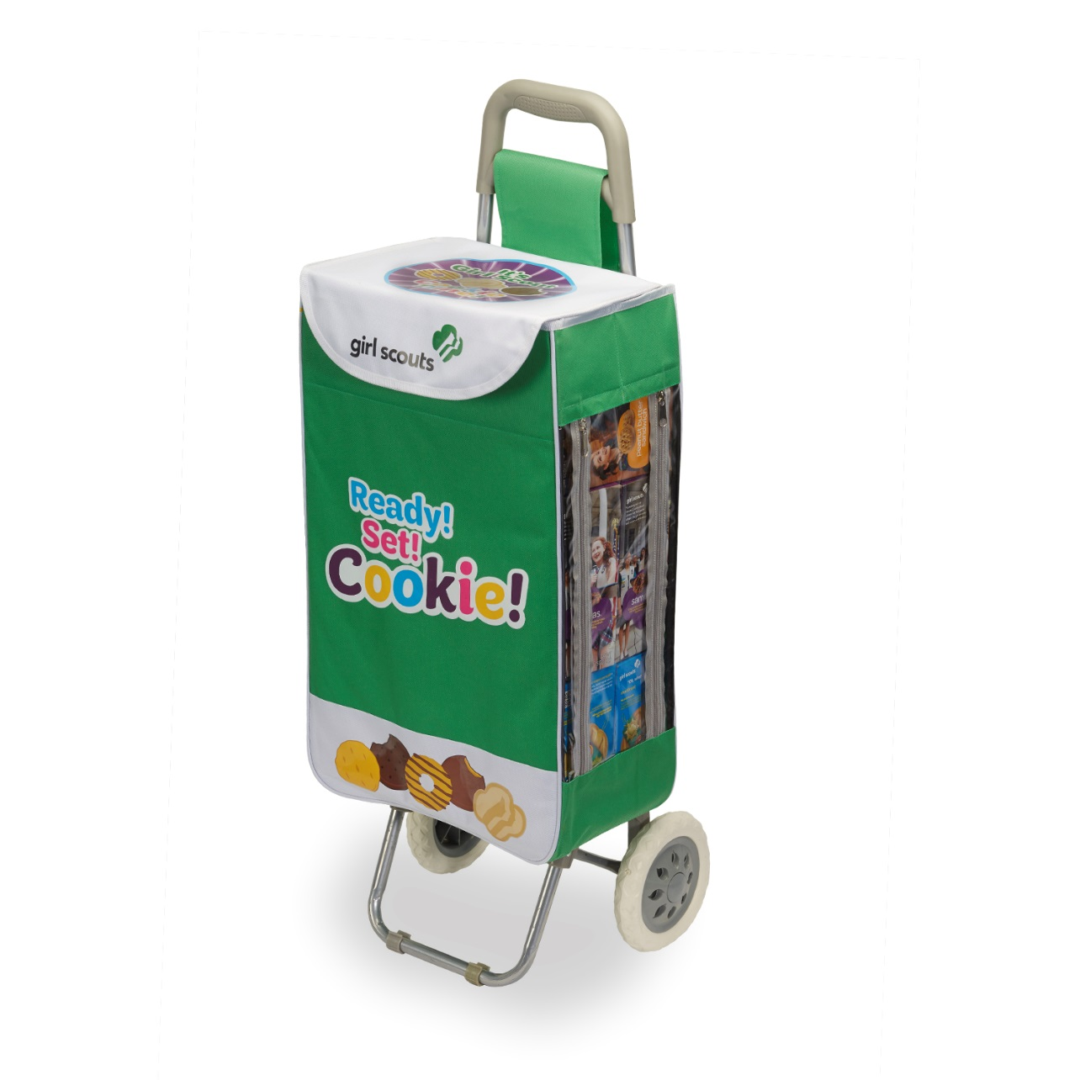



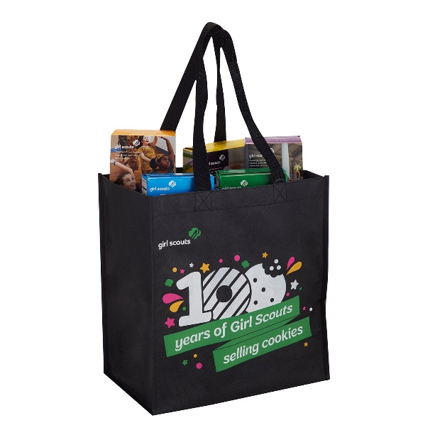
ACH
Cookie Retail Merchandise
Car Magnet $5
Rollabanas $7.95
2017 T-Shirt $20 - $24
(price is dependent on size)
Tote Bag $2.95
Cookie Cart $35
Build brand awareness and boost your sales!
These marketing tools can be found in our GSGLA stores beginning Dec. 1.

Slide 77





ACH
Cookie Retail Merchandise
Button Pin $1
Stop Sign $7.95
Tablecloth $11.95
Car Flag $7.95
Yard Sign $8
Build brand awareness and boost your sales!
These marketing tools can be found in our GSGLA stores beginning Dec. 1.

Slide 78


