Slide 1
2017 Cookie Program
Girl & Family Training

Slide 2
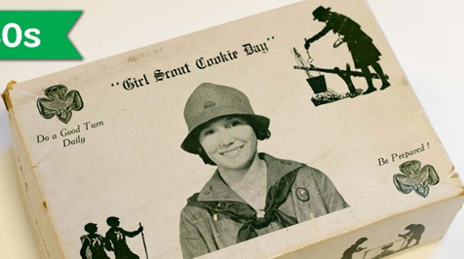
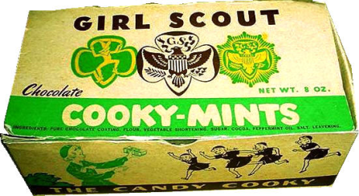
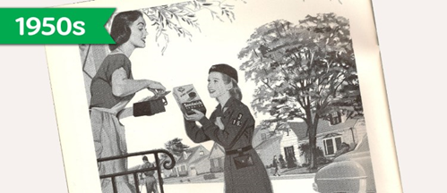
years of cookies!

Slide 3
5 Skills for Girls
This is what it is all about!
Goal Setting
Decision Making
Money Management
People Skills
Business Ethics
Girls learn these 5 Skills today, that will serve them for the rest of their lives. Future employers are looking for people who can lead, get along with others, and influence outcomes. Let’s change the world!

Slide 4
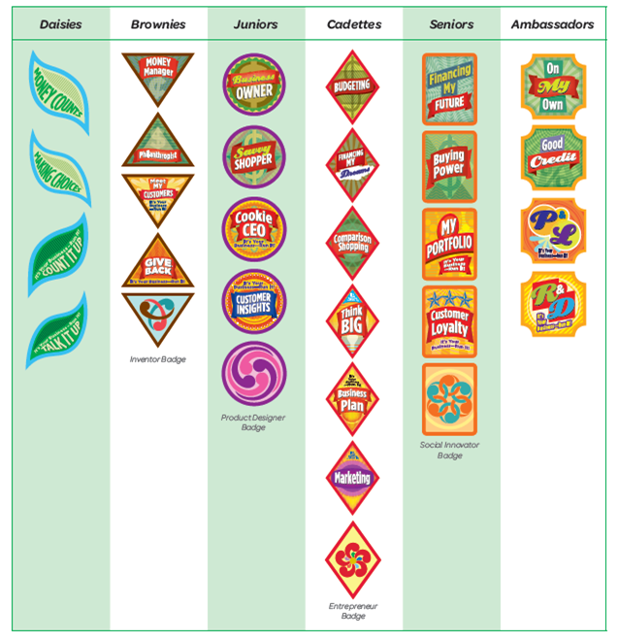
Pins & Badges
Girls earn the Cookie Activity Pin as they learn the 5 Skills.
Cookie Business and Financial Literacy Badges are a way for girls to prepare for the Cookie Program.

Slide 5
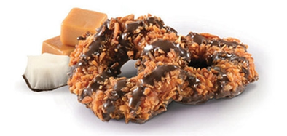
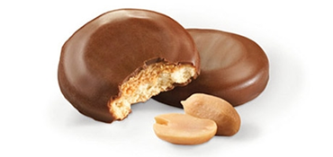
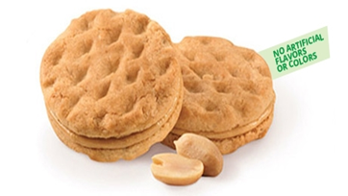
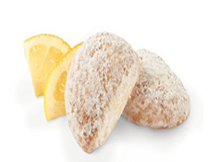
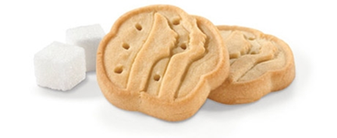
Super 6 Cookies
$5 per box
Thin Mints
Samoas
Tagalongs
Trefoils
Savannah Smiles
Do-Si-Dos

Slide 6
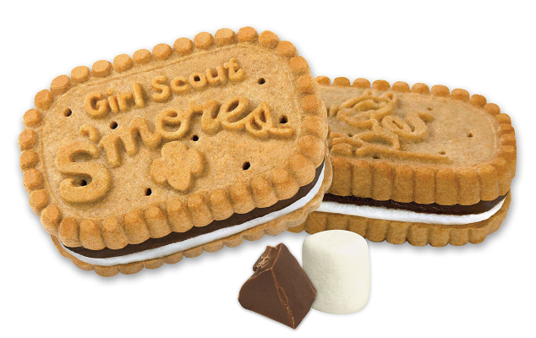
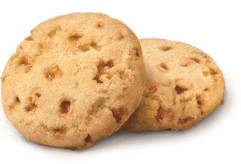
NEW - S’Mores!!
$6 per box
Crunchy Graham Cracker Sandwich Cookie with Creamy Chocolate and Marshmallow Filling
Gluten Free
Toffee-tastic

Slide 7
Gift of Caring
Gift of Caring is a great way for your customers to support the Girl Scouts and other great organizations without consuming any calories!
Encourage each customer to donate a box of cookies to Gift of Caring for $5. At the end of the sale, the cookies are delivered to the great organizations listed below. Many customers who don’t want to buy cookies will still donate if you just remember to ask. Receipts for this tax deductible donation are available.

Slide 8
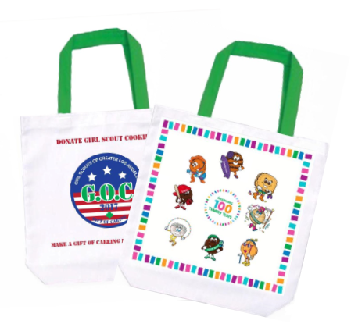
2017 Rewards
Starting Inventory Rewards – 75%
Tote Bag
Troop Leader Vintage Cookie Tray

Slide 9
ACH
Participation & Special Patch Rewards
OR
12 - 23
Participation Patch
24+
Participation Patch
2016 Fall / 2017 Cookie Combo Patch
Girls must have met the
2016 Fall Program criteria AND
Sell 250+ boxes of cookies
Cookie Club Patch
24+ valid emails sent via Cookie Club

Slide 10
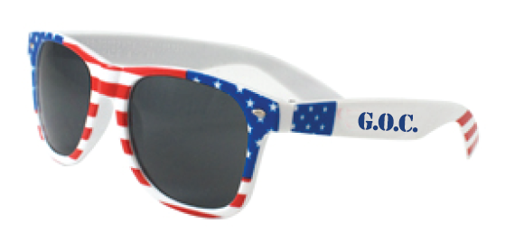
ACH
2017 Gift of Caring Rewards
20 GOC
Sunglasses
10 GOC
Patch
30 GOC
Pen

Slide 11
2017 Rewards Events
Club 500 is May 20, 2017
Six Flags Hurricane Harbor
Elite 1000 is May 6, 2017
Disney’s Yes Program
Disney Resort

Slide 12
2017 Rewards Events
1500+
S’More Adventure Weekend June 10-11, 2017
Camp Osito Rancho
2000+
Limo Ride & Lunch with Lise Luttgens, CEO
June 21, 2017

Slide 13
ACH
2017 Reward Event Option
OR
3000+
38mm Apple Sports Watch
3000+
VIP Experience at Universal Studios
June 17, 2017

Slide 14
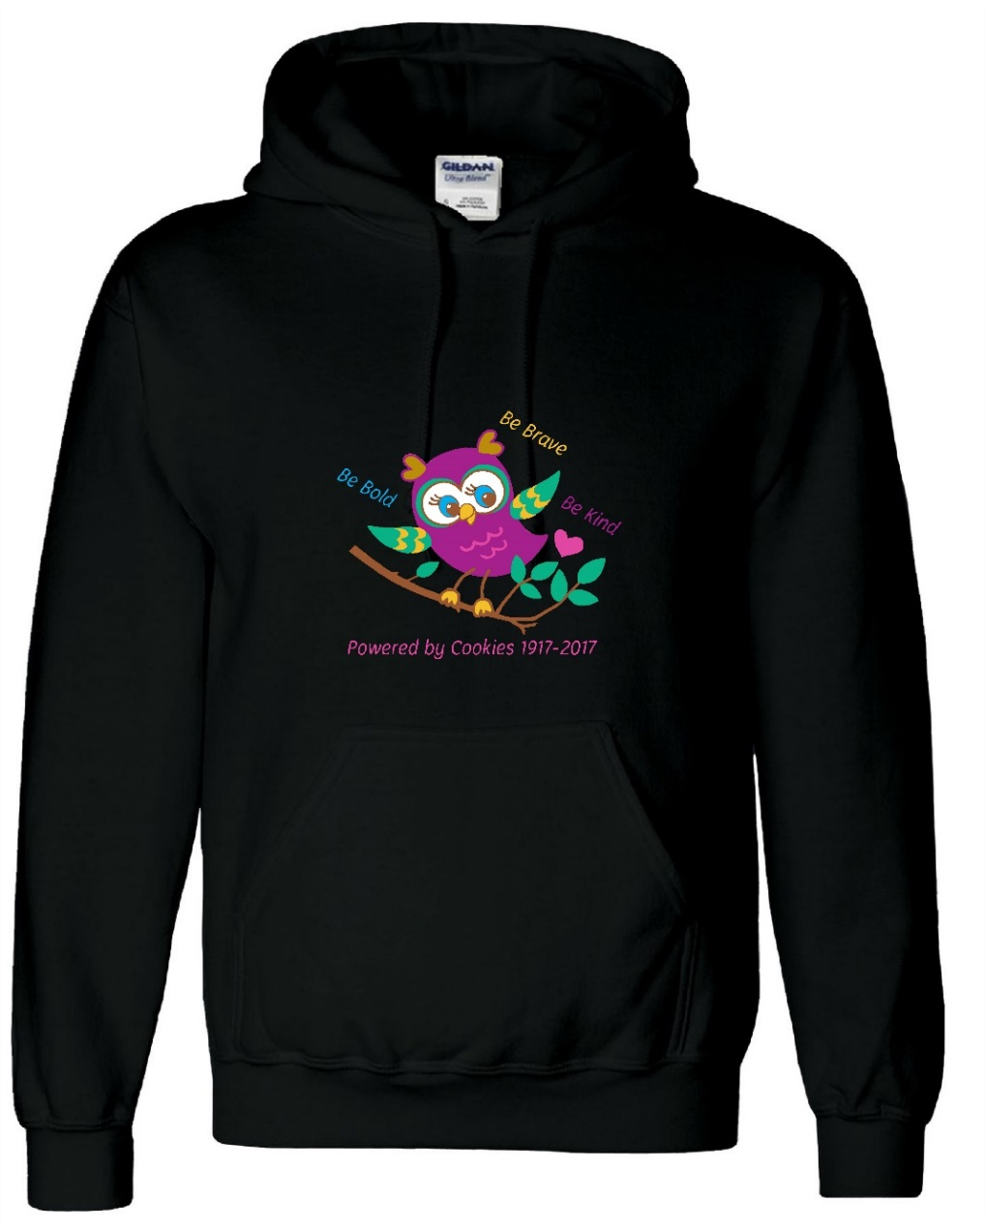
Troop PGA Rewards
$15 Cookie Dough
Troop PGA 240+
Hoodie Sweatshirt
Troop PGA 320+
Each participating girl plus 2 Troop Leaders
PGA = Per “Selling” Girl Average (NOT registered girls)

Slide 15
ACH
Program Credit - Reward
An optional reward for levels that offer only an event (500+, 1000+, 1500+, and 2000+)
A GSGLA Gift Card will be issued.
Can only be used internally (GSGLA) for:
Retail In-Store Purchases
Girl Annual Membership
GSGLA events
GSGLA specialty and resident camps
Destinations
Detailed use and redemption procedures will be provided to recipients.

Slide 16
Timeline
January
Attend a Cookie Kick-Off Rally
Jan 27-28 Cookies Arrive
Jan 29 – Go Day!! Absolutely NO orders should be taken before today.
Jan 29 – Open your “lemonade stand”
February
Money Mondays – turn in money to troop on Mondays
Feb 10 - Boothing begins
Feb 24 – 26 National Girl Scout Cookie Weekend
March
Mar 12 - Cookie Program ends – ALL MONEY IS DUE TO TROOP
May/June
Cookie rewards delivered to Service Unit.

Slide 17
Responsibilities
Girls & Adults:
Must follow all rules & guidelines listed on Parent/Guardian Permission Form and in the Family Guide.
Must follow all troop deadlines regarding taking cookies and turning in money.
Must adhere to all rules regarding storing and selling cookies.
Must sign a receipt for any cookies taken from or money given to your Troop Cookie Chair.
Responsible for all cookies received.
Responsible for all money collected.
Communicate with your Troop Cookie Chair.
Consequences will apply if rules are ignored.
Cookies
Responsible Ingredients

Slide 18
How You Can Sell Cookies
Door-to-Door (aka Walkabouts)
Only in residential areas
No stationary booth – must always be walking
Only during daylight hours
You may not “claim” a neighborhood
Adults must always accompany girls
“Lemonade” Stands
Only in residential areas
Only where the girl lives, not someone you know
Stationary location in front of residence – not on sidewalk, street corner, parking lot, etc.
Adult must always be present

Slide 19
How You Can Sell Cookies
Internet
You may “advertise” that you are selling cookies, but cannot complete the transaction through the internet
Facebook & Twitter, YES!
Craigslist, eBay, Amazon, NO!
Little Brownie Baker Cookie Club, YES!
Allows girl to email potential customers through a secure website and take their orders.
All payments and delivery must be made in person
Parent/Caregiver Work
With permission, girls may walk around parents’ or caregivers’ work place and sell to employees (not business patrons.)

Slide 20
How You Can Sell Cookies
Boothing – February 10 to March 12, 2017
Stationary location in front of non-residential establishments.
Booth locations are pre-authorized by GSGLA, chosen by Troop Cookie Chair.
You may not set up a booth in front of a business without obtaining Service Unit approval.
If you know of a location where a booth would be appropriate, you must contact your Troop Cookie Chair who will submit the suggestion to the Service Unit Cookie Chair.
“Special” one-time-only booths may be requested in special instances (e.g. at a church, sporting event, school events, etc. )
You must strictly follow boothing rules and regulations.

Slide 21
Boothing Rules and Safety
Communicate with your Troop Cookie Chair about site do’s and don’ts.
Hours / Days
8AM – 8 PM, (only Junior level and older allowed after 6 PM.)
Outside regular school hours.
Daisies should booth only for one hour at a time.
Participants
Minimum of 2 girls and 2 adults at each door
Exception
Senior/Ambassadors – OK for two girls and one female adult per door.
Cadette/Senior/Ambassador - One Girl / One Parent starting on Feb___.
Female or Parent must be a registered Girl Scout if 2/1 or 1/1
Safety
Bring money to make change. (Adults handle all money for Daisies.)
Adults hold large bills and make plans to deposit quickly.
Girls never approach cars, nor follow customers to their car.
Always bring water, important phone numbers and your reservation confirmation.

Slide 22
Boothing Rules and Safety
Appearance and Conduct
Girls should wear a membership pin, uniform, sash, vest or Girl Scout T-shirt. Adult also should be appropriately dressed.
No tank tops, no open-toed shoes for girls or adults.
Girls should be facing customers, not talking or playing with each other and NOT using their cell phones.
No eating while at the booth.
Girls should greet people warmly, smile and remain pleasant under all circumstances.
Arrive on time and start packing up 5-10 minutes before shift is over.
No tagalongs (e.g. siblings, friends, relatives ) at the booth.
The girls, and not the adults, should take the lead in selling the cookies.
Be ready to answer questions about the cookies and what your troop is going to do with its cookie proceeds.
LEAVE NO TRACE - Clean up all trash. Do NOT use the trash cans at the location. You must take all your trash with you, including empty cases.

Slide 23
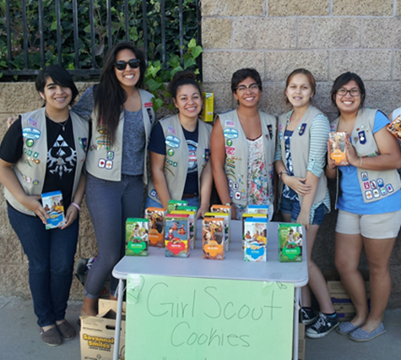
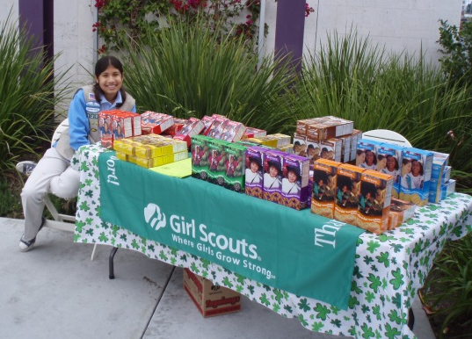
Important Information About Booths
You are representing all Girl Scouts. Please act and dress accordingly.
Girls Scouts is encountering more and more locations that are reluctant to allow booths. This means that it is very important that we follow the rules of the existing locations very strictly and that we make a very good impression so that Girl Scouts will continue to be welcome.

Slide 24
Handling Money and Cookies
Payment is collected only when cookies are delivered, except for Gift of Caring.
Checks should be made payable to “Girl Scout Troop XXXX.”
Girls should not accept bills larger than $20.
“Money Mondays” - Turn in any money collected in the prior week.
Monies should be submitted to the Troop Cookie Chair in their original format. i.e., if you receive cash, you turn in the cash. Money should never be deposited into a personal bank account. (Good intentions or not, that is embezzling.)
Your Troop Cookie Chair (TCC) will receipt every cookie and money transaction. Keep your copy of the receipt for your records.
Touch-base Tuesdays - Contact the TCC and let the TCC know if any additional cookies are needed or if the girl is having trouble selling her inventory. Communication is critical!
Cookies should be stored indoors in a controlled environment away from pets and pests.

Slide 25
Consequences
Troops, girls and parents must follow all of the rules of the Cookie Program. Possible consequences for failing to follow the rules:
Loss of girl or troop rewards earned
Loss of troop proceeds
No future boothing
Most common violations
Selling for the incorrect price
Doing a walkabout in a commercial area
Selling in front of a school without approval
Boothing outside of GSGLA borders
Girls selling or delivering alone
Incorrect girl/adult ratio at booth
Inappropriate behavior at booth
Not cleaning up after at booth site
Failure to pay for cookies

Slide 26
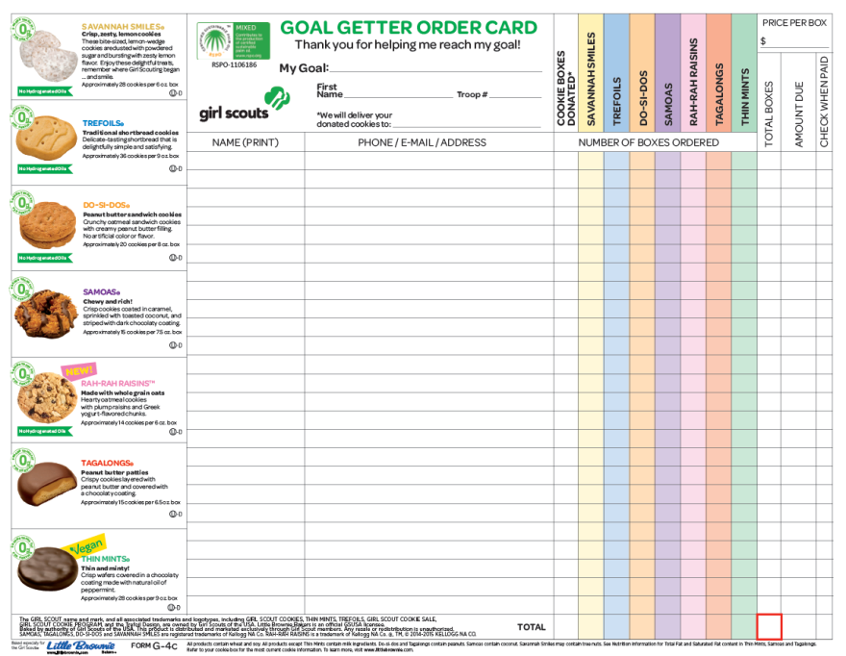
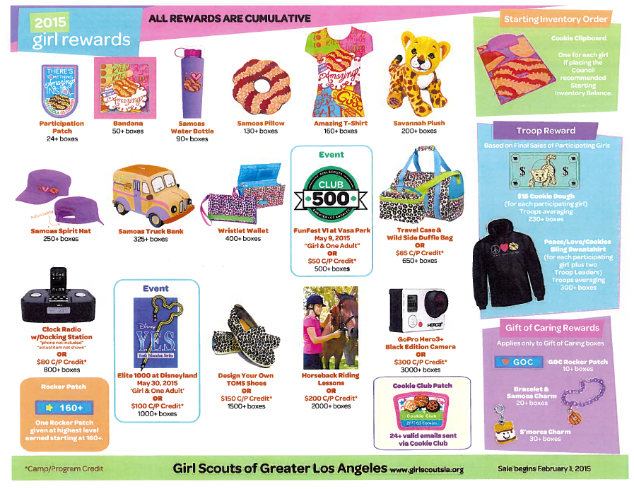
Order Cards
Girls will receive at cookie distribution.
Girls can track customer orders and
contact information for call backs.
Rewards displayed on the back of the card.

Slide 27
Cookie Club
www.littlebrowniebaker.com
In Cookie Club, girls email customers customizable eCards asking for online orders. Customers place orders online, and the orders are automatically recorded in the girl’s Cookie Club account. It’s the faster, easier way to reach high goals. Girls can also play cookie games, learn cookie crafts and learn how to decorate their booths and sell cookies.

Slide 28
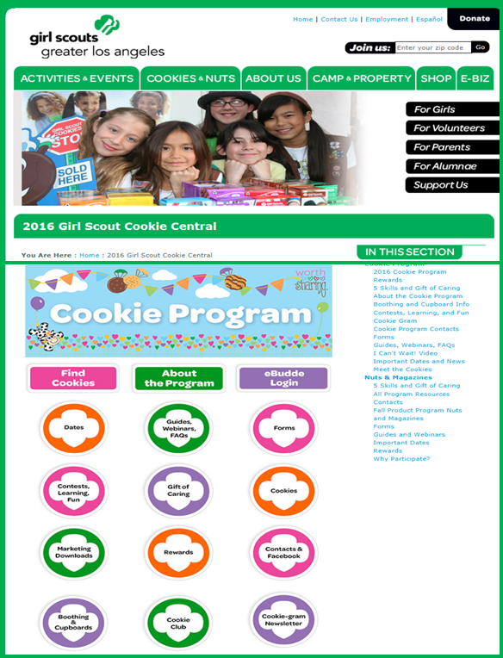
Cookie Central
Should you have any questions, please contact your Troop Cookie Chair.
Information can also be found at Cookie Central on the GSGLA website http://www.girlscoutsla.org including:
Important dates
Cookie Locator & mobile app
Link to Cookie Club
Templates for signs
Tips & Activities from Little Brownie Baker
Cookie recipes, Volunteer Guides, & more!
EVERYTHING you need for a successful Cookie Program!
Cookies
Responsible Ingredients

Slide 29
Thank you
for allowing your
child to participate in
GSGLA’s 2017 Cookie Program

