Slide 1



2016 Fall Product Program
Troop Training

Slide 2
How girls participate
Nuts and candy in person via order card for delivery
  Girls can hand out business cards and magazine fliers with their store code
Online for girl delivery (order card products only)
Online for shipment (up to 25 nut and candy products)
Online magazine orders
Residential Walk-abouts and Lemonade Stands (nut and candy products)
Gift of Caring products
It can be as simple as sending out emails!
Notes:
This is a TROOP OPPORTUNITY SALE that can impact GIRLS. TROOPS, and SERVICE UNITS.

Slide 3
Girl Business Cards
Girls can download business cards from www.gsnugsandmags.com/gsgla.
Customers log on to the girl’s storefront and order products.

Slide 4
Girl Flier - Magazines

Slide 5

What’s new for 2016
Three new Trophy Nut products:
  Dark Chocolate Sea Salt Almonds ($7)
  Cracked Pepper & Sea Salt Cashews ($7)
  S’mores Mix ($9)
  New magazine vendor—M2 Media
    Over 1000 titles
    Nuts, candy and magazines are all managed through one integrated system
    Simplified timeline
    All orders are due/end October 23

Slide 6
September
Early September
Plan a troop meeting/parent and girl training.
September 23
Deadline for troops to submit ACH Debit Authorization form, voided troop check and TFPC Position Description & Agreement online (earlier is better!).
Troops receive access to M2OS.
Troops enter bank account information in M2OS.
September 30
Order taking begins for nuts and magazines.
Email parents to go to www.gsnutsandmags.com/gsgla to start their online sales campaign.
Previous year participants will also receive an email reminder

Slide 7
October
October 23
Online sales end at 9 PM.
Nut orders due to troop. Parents enter paper orders in M2OS by 9pm and turn in a copy of the order card to the TFPC.
October 25
TFPC to enter/review Nut Orders in M2OS by 9 PM and notify SUFPC when complete.

Slide 8
November
November 11-13
Trophy Nut order delivery to Service Units and distribution to troops (dates/locations vary).
November 11-20
Sales via Residential Walk-abouts & Lemonade Stands with product in hand. No selling in commercial areas!
November 20
Fall Product Program ends.
November 28
All GOC, allocations, and troop-to-troop transfers must be completed in M2OS no later than 9 PM.
Late November
Ensure funds are deposited to troop account in time for all funds to be available by December 6.

Slide 9
December
December 2
Last day to notify your PSM if you need to adjust your ACH debit.
December 6
ACH Debit from troop bank accounts.
Due date for troops to turn in Discrepancy Reports.

Slide 10
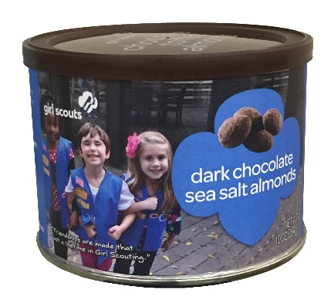

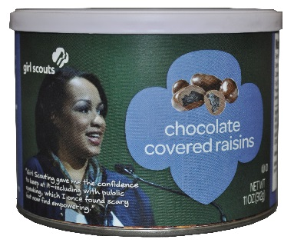

Troop Proceeds
Troops earn 25% of the purchase price on nut products, including all online gift items.
Troops earn 20% of the subscription price of magazines.

Slide 11
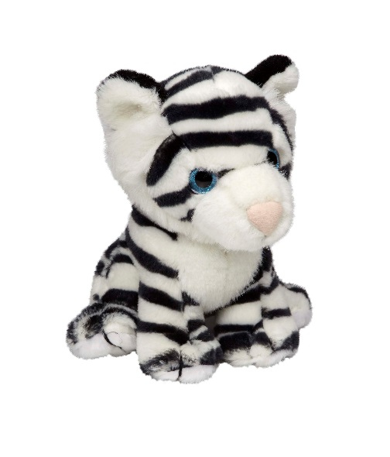
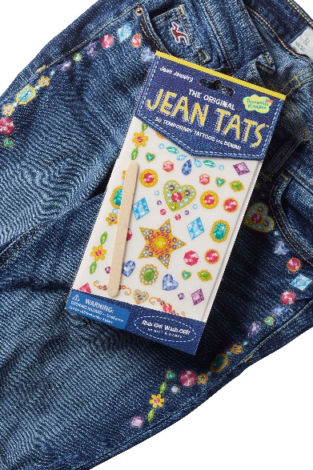


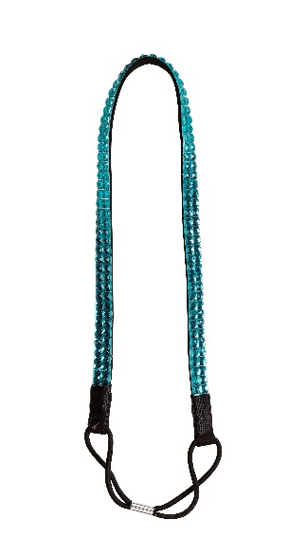
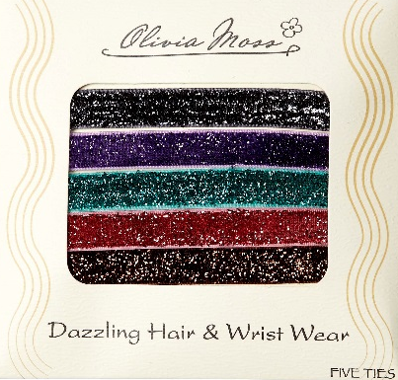



Rewards
Rewards are “unitized” whether girls sell nuts or magazines
Troop reward: Average 50 units per participating girl to earn a movie ticket for each girl and two adults
Participation patch and rocker charms
Metallic tattoos
Dazzling Hair Band
& Ties
Baby White Tiger Plush
Jeans tattoos

Slide 12


Rewards –Unique Patches!
Avatar patch
Create their Me2 avatar
Send 12 valid emails by October 14
$250 in combined nut and magazine sales
Fall and Cookie Combination Patch
Create their Me2 avatar
Send 6 valid emails by October 14
$100 in Nut/Magazine sales
250 boxes sold in 2017 Cookie sales

Slide 13
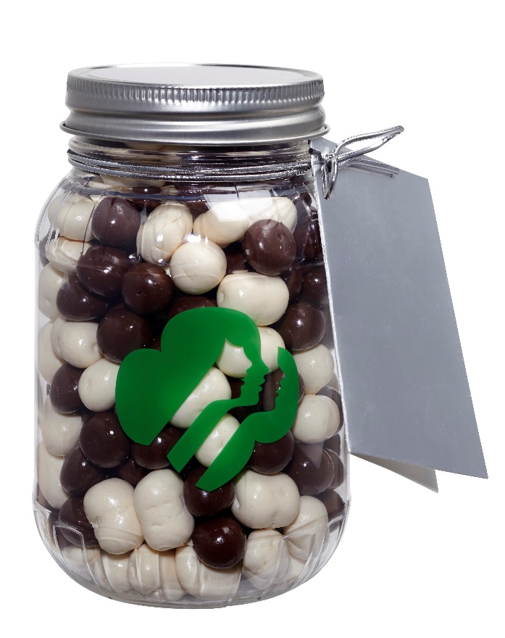

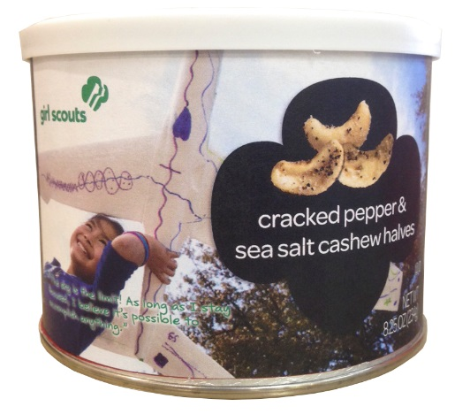
Trophy Nut Products
16 products plus GOC on the order card
Three price points: $5, $7, and $9

Slide 14
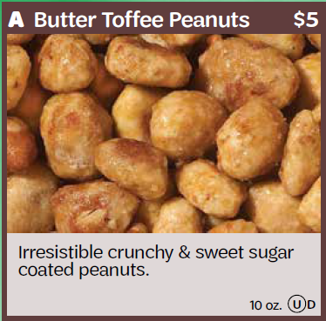
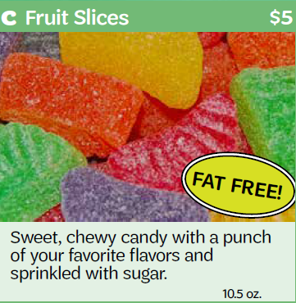
Products & Pricing
Spicy Cajun Mix
Fruit Slices
Butter Toffee Peanuts
#1 Seller!
$5/can

Slide 15
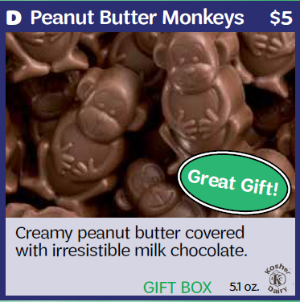
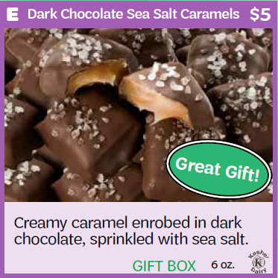
Products & Pricing
Peanut Butter Monkeys
Dark Chocolate Sea Salt Caramels
$5/box

Slide 16
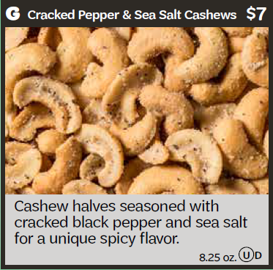
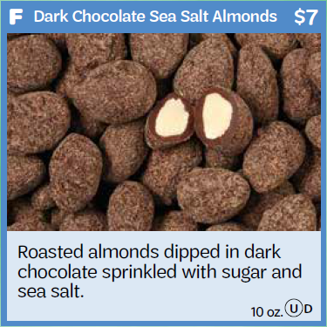
Products & Pricing
Dark Chocolate Sea Salt Almonds
Cracked Pepper & Sea Salt Cashews
$7/can

Slide 17
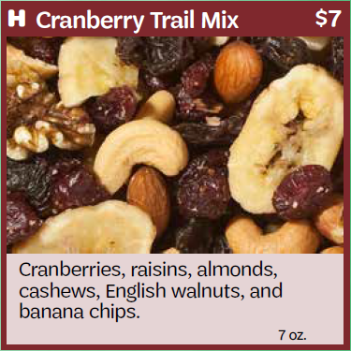
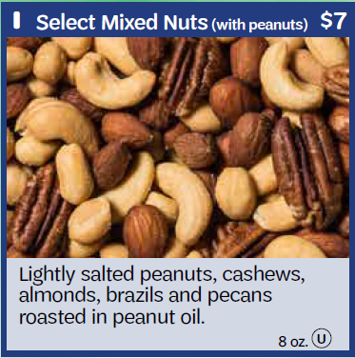
Products & Pricing
Select
Mixed Nuts
Cranberry
Trail Mix
$7/can

Slide 18
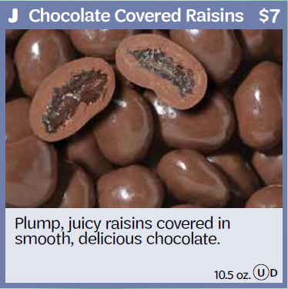
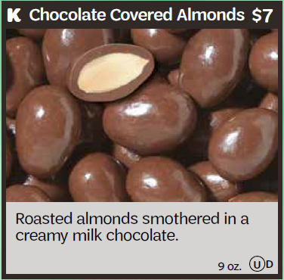
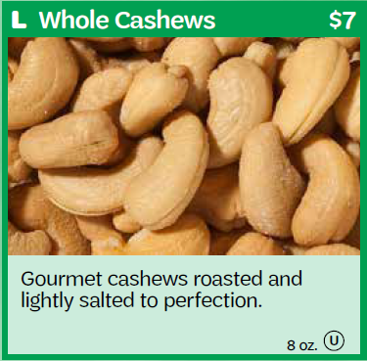
Products & Pricing
Chocolate
Almonds
Chocolate Raisins
$7/can
Whole Cashews

Slide 19
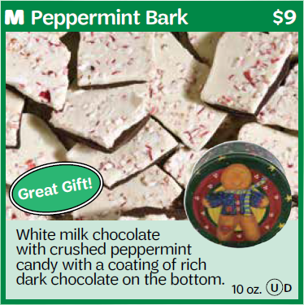
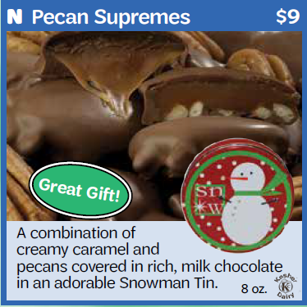
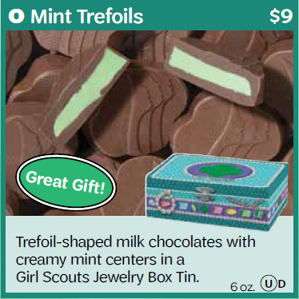
Products & Pricing
Peppermint Bark
Pecan Supremes
Mint Trefoils
$9/tin

Slide 20
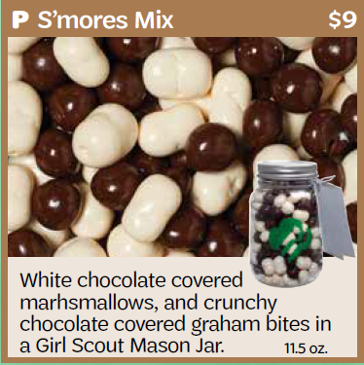
Products & Pricing
S’mores Mix
$9/jar

Slide 21



Gift of Caring
Customers purchase nut products to donate.
Girls need to sell this concept.
Ideal for customers who do not want a product, but do want to support their favorite Girl Scout.
“Virtual” donation—customers and girls do not order or handle the product.
GOC donations count towards rewards like all sales.
Can be ordered as a stand-alone product online.

Slide 22





M2 Media - Magazines
Over 1000 titles!
System is fully integrated so there is nothing for the troop chair to do!
  Units and money will be automatically tallied
  Rewards will be applied

Slide 23

Online Program
One system!
Girls build their Me2 avatar.
Girls send emails to family and friends to purchase nuts and magazines from their online store. One email for both products!
Customers select shipment or girl delivery.
Council will import troops and girls.

Slide 24
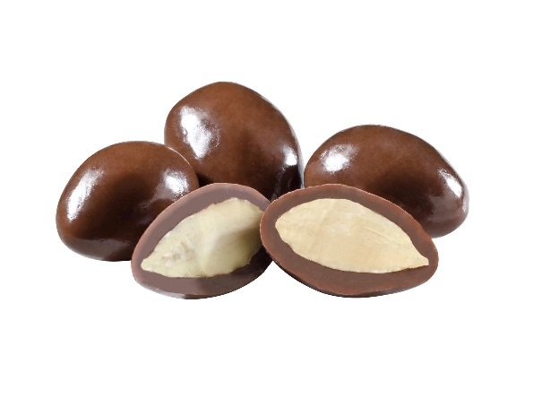
Pre-Planning Checklist
  New troops open a bank account.
  Submit ACH Debit Authorization and Troop Fall Product Chair Position & Agreement forms at www.girlscoutsla.org.
  Girls must turn in Parent/Guardian Permission & Responsibility Agreement.
  Train girls and parents.
  Review Safety Activity Checkpoints.
  “Like” GSGLA Cookie & Nut Friends on Facebook.

Slide 25

Materials
Each girl receives:
  Trophy Nut Order Card
  Money Envelope
  Family Letter
  M2 Online Flyer
  Business cards (available online)
Each troop receives:
  Fall Product Program in a Nutshell resource guide
  Troop Fall Product Guide (available online)
  Envelopes
  Receipt Book
  GOC receipts

Slide 26
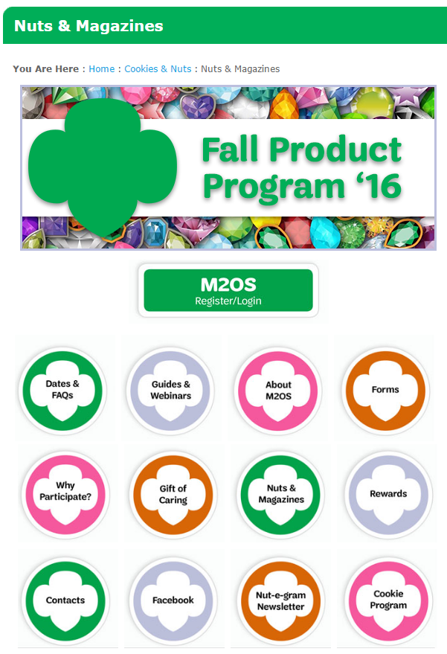
Fall Product Central Homepage
Note the single login link

Slide 27

Parent & Girl Training Agenda
  Inspire! Encourage! Motivate!
  Why participate in the Fall Product Program: 1. Generate start-up funds for the year.
      2. Girls learn 5 Skills for Girls.
  Troop and girl goals.
  Dates and deadlines.
  Money Handling.
Goal Setting
Decision Making
Money Management
People Skills
Business Ethics

Slide 28
Troop M2OS Set-up
  TFPCs will receive an email from M2OS with log in information.
  Manage troop sales from the dashboard.

Slide 29
M2OS Troop Dashboard

Slide 30
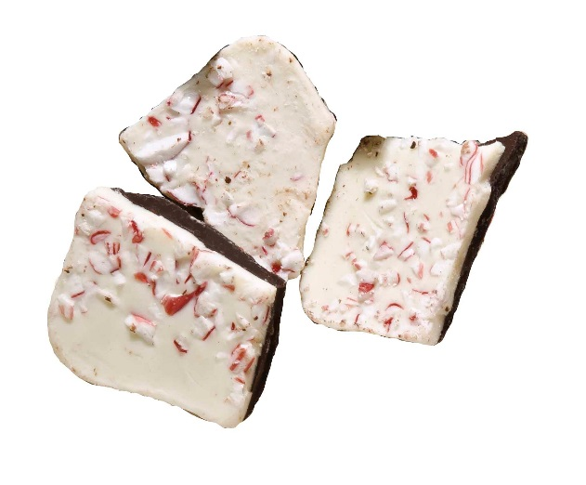
Tracking Sales
Enter in M2OS:
  Bank information.
  Girl allocations and Gift of Caring.
  Girl payments to troop.
  Verify troop transfers entered for you by SUFPC.
  Verify in M20S:
  Girl orders placed by parents; or enter girl orders from order card

Slide 31



Invite Girls to Participate
Send parents an email with the M2OS link on Sept. 30: www.gsnutsandmags.com/gsgla.
Girls create their Me2 avatar.
For best results, girls should upload a picture or create a video.
Send emails to friends and family.
Share on social media.

Slide 32
Parent Set Up Account

Slide 33
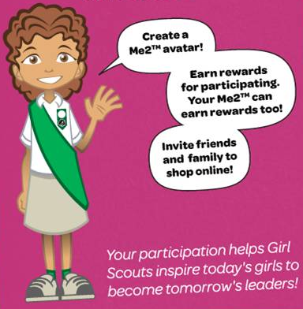
Create a Me2 Avatar
She talks!
Girls will customize hair, eyes, skin, outfit, etc.
Girls will earn virtual “rewards” for completing tasks
Girls will have fun in their virtual office as they invite family and friends to shop online
Girls earn a patch with their customized avatar for sending 12 valid emails by Oct. 14 and selling $250 in nut and magazine products

Slide 34
Create a Me2 Avatar

Slide 35
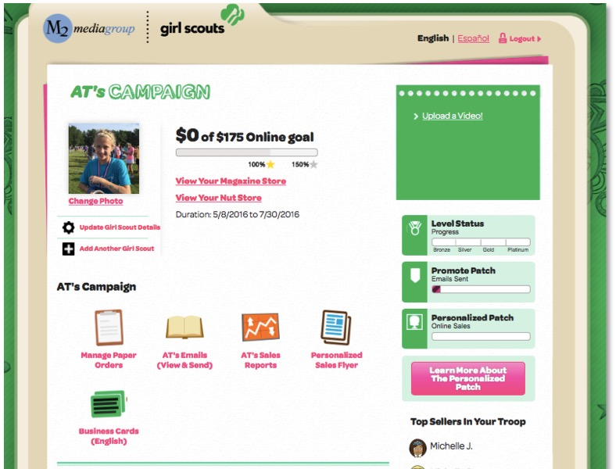
Girl Dashboard

Slide 36
Girl’s Storefront Preview

Slide 37
Social Media Links

Slide 38

Customer email

Slide 39
Customer Landing Page – Nut Products

Slide 40
Promise Confirmation
System explains girl delivery and in-person payment

Slide 41
Shipping Information
Customer can choose shipping method to save $$$

Slide 42
Customer Landing Page - Magazines

Slide 43
Magazine Gift Cards

Slide 44
Customer Check-out

Slide 45
Renewal Information

Slide 46
Customer Thank You & Print Receipt
Gives customer option to go to other store

Slide 47
Orders Linked Back to TNOS
Online orders will appear here when Troop selects Orders

Slide 48
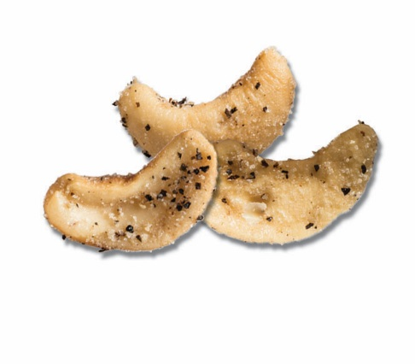
Planning Your Nut Order
Enter nut/candy order card quantities in M2OS by October 25, 9pm.
Orders for delivery include order card orders and orders placed on line (promises) for delivery
Orders do not have to be in whole cases, but you might want to round up if you need 9 or more of any one product.
This is the only order, so order a little extra, especially the most popular items.
Enter additional product as an “Initial Booth Order,” then allocate to girls as they sell the product.
Do not enter orders that have already been entered online! Only enter order card orders.

Slide 49
Placing a Paper Order in M2OS (by Girl)
Enter order card orders
Enter girl orders

Slide 50
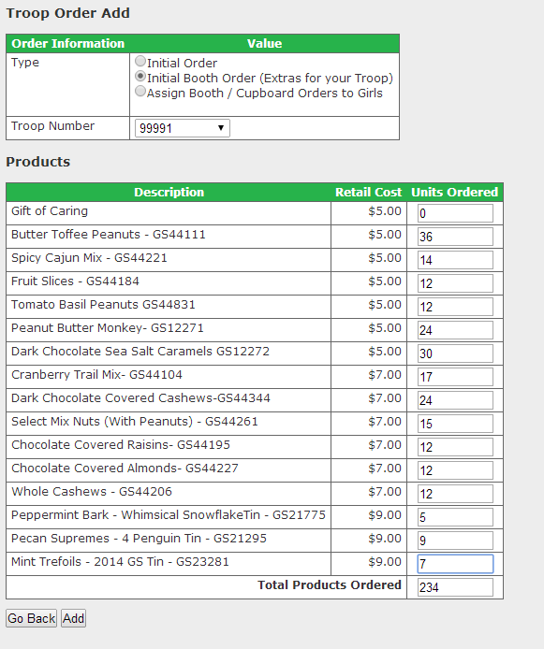
Placing an Order in M2OS (Initial Booth Order)

Slide 51
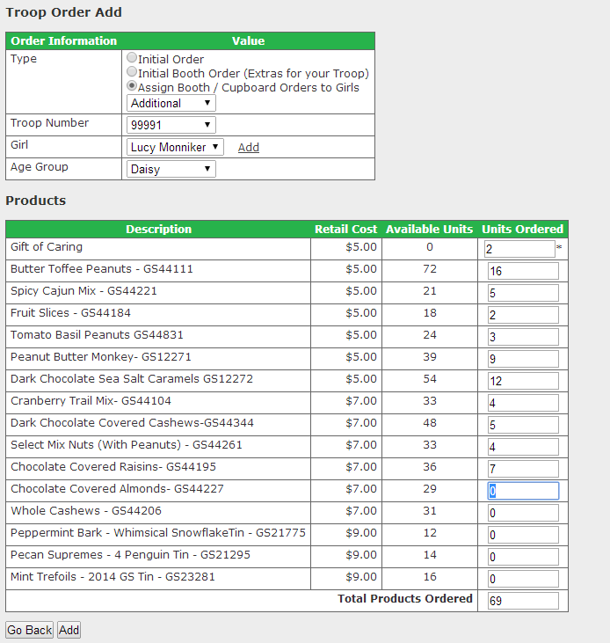
Allocating Girl Orders in M2OS
Here is the detail for what can be allocated to girls.

Slide 52
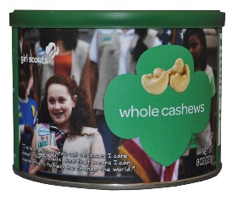
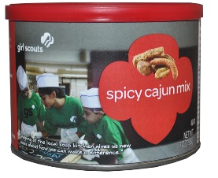
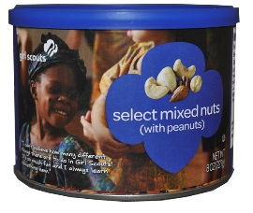
Trophy Nut Order Pick-up
November 11-14. Dates/times vary—your SUFPC will give you specifics.
Be on time!
Count, count, & recount. Get a receipt to confirm your delivery.
Take orders straight home
Have parents sign receipts for the girls’ orders
Store product properly. Melted chocolate is not considered damaged.

Slide 53
Receipts
Receipt everything!
  Product given to girls
  Money received from girls

Slide 54
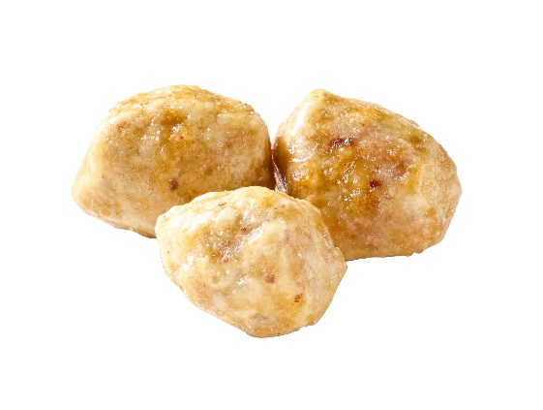

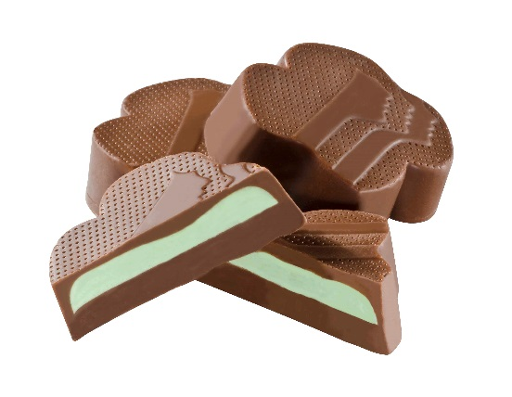
Returns, Exchanges & Transfers
No returns.
Replace damaged product at a service center.
No exchanges.
SU can facilitate and enter troop-to-troop transfers.
M2OS only allows transfers of “Initial Booth Order” product.

Slide 55

Selling Guidelines
Girls may do residential walkabouts (door-to-door sales) and lemonade stands (a booth at a private residence where the girl resides) Nov. 11-20.
No booths on commercial or non-residential property.
No walkabouts in commercial or public areas.
Troops must not solicit booths; your SU is working on cookie booths right now.
No cupboards. Order additional product if you think girls will continue to sell.

Slide 56

Cash Handling
Payment is collected only when product is delivered. GOC payments may be collected at time of order.
Troops may use their credit card reader for residential walkabouts and lemonade stands.
Receipt every transaction.
Record girl payments in M2OS.
Understand girl vs. troop responsibility.
$300 maximum debt limit guideline.

Slide 57
Accepting Checks
Determine your troop’s check amount limit (i.e. no more than $50) to mitigate loss.
Put the girl’s first name and last initial in the Memo section of a check.
Record the issuer’s phone number and driver’s license number if possible.

Slide 58
Banking and ACH Debit
Troops deposit money promptly and frequently.
Troop bank accounts will be “pinged” to verify account information is correct (no fee).
One ACH debit, December 6. Troops are responsible for making sure their bank will release deposited funds in time for the ACH debit.
ACH failures will result in $25 administrative fee, in addition to any bank fees.

Slide 59
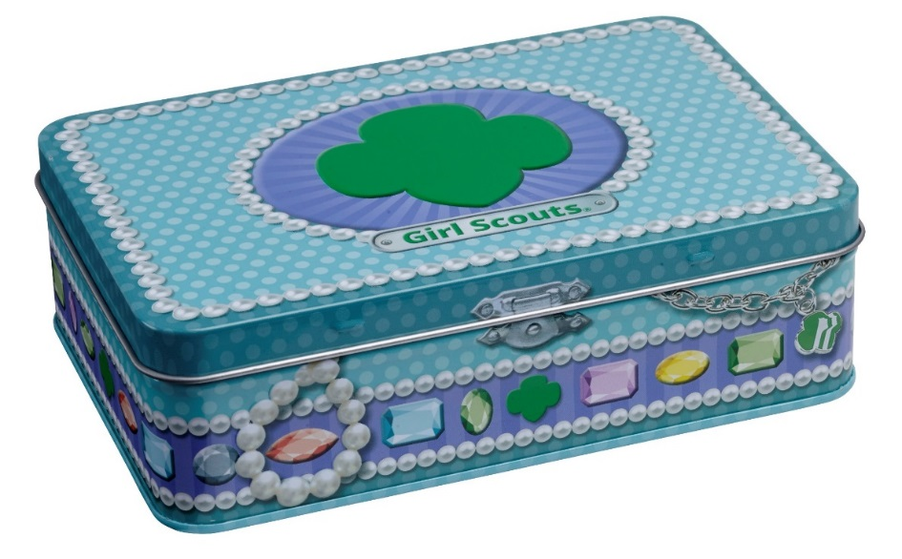
Returned Checks/Parent Issues
Contact check’s maker as soon as possible to try to resubmit check.
If necessary, forward original or bank copy to council within 3 business days.
Submit Discrepancy Reports with supporting documentation at end of program if parents owe money.
Follow detailed guidelines from your Troop Guide.

Slide 60
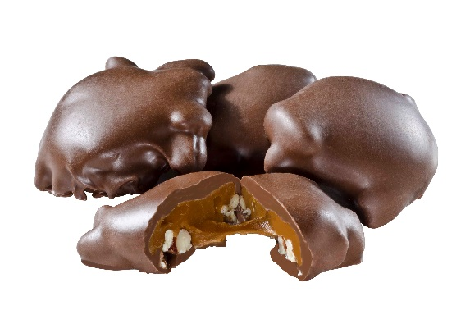
Crisis Management
If you receive a serious product complaint, call the Customer Care Hotline:
213-213-0123
“Contain” the situation.
Gather relevant information.
Fill out an Incident Report.
Refer all media inquiries to the council.

Slide 61

Wrap-up
Finish strong!
Allocate all products down to zero.
Verify Troop-to-Troop transfers so you pay council the right amount.
Record Gift of Caring donations.
Deposit money in time for Dec. 6 debit.
Turn in Discrepancy Reports as necessary.
Celebrate your girls’ successes!
Rewards should be ready in January.

Slide 62




Thank you for spending your time with us
for this important training!

