Slide 1



2012 Troop Cookie Chair Training
2012 Cookie Program

Slide 2



Critical Dates (Page 2, Troop Guide)
Initial Order taking begins January 20
Booth Scheduler opens January 29 (6:30 pm)
Initial Order Due in eBudde February 5 (11:30 pm)
Initial Order Delivery February 23-28
Cupboards open March 1
Boothing March 2-25
Cases only at cupboard March 2-14
Cupboard even exchanges March 15-22
First ACH Debit March 14
Program ends March 25
Finalize transactions/recognitions April 2 or earlier
Final ACH Debit April 6
2012 Cookie Program

Slide 3



Direct Sale Information (Page 4, Troop Guide)
Cookies on the Street
Orange County, San Diego & San Gorgonio – Jan 29
Central CA Coast – Initial Order starts January 15
Key Messaging
SanG & OC have different bakers – different cookies.
The public knows our brand!!! e.g. Samoas & Tag, no Savannah Smile
Boothing ends early. e.g. OC ends March 11; SanG ends March 15
No one has our Cookie Locator powerhouse to connect customers
We are here to help
FAQ available to explain exactly what’s what
SoCal Operating Principles to handle cross border issues
Order Receipts to reinforce our Girl Order card
Can sell across the border via friends/family ONLY – no boothing at any time
2012 Cookie Program

Slide 4

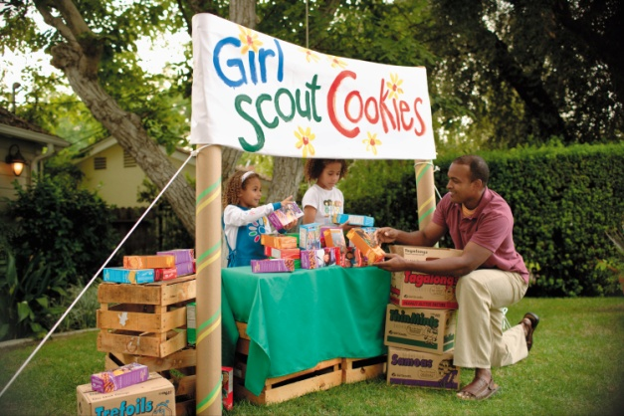

Cookie Planning Checklist (Page 5, Troop Guide)
TCCs must have completed background check online at www.girlscoutsla.org. Click on “For Volunteers”. Password is “Volunteer”. Safe and secure.
Turn in ACH form, voided check (copy ok) & Troop Chair Agreement to SUCC to receive sales materials.
Make sure you have a copy of each girl’s signed Parent/Guardian Permission Agreement on file with the troop leader.
Review materials list.
Hold a parent meeting (review 5 Skills for Girls).
Set troop & girl goals.
Visit http://vipetraining.littlebrownie.com to view
eBudde guide and complete training.
Set up your troop in eBudde after your SU Cookie
Chair gives you access (Do not wait until I/O is due!)
2012 Cookie Program
Notes:
Only volunteers who have not done so need to complete the background check.
www.girlscoutsla.org; Click “For Volunteers”
Click “Become a Volunteer”
In Step 2, click on office to send your CBC results to
Password to use is “Volunteer”

Slide 5
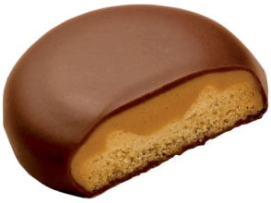
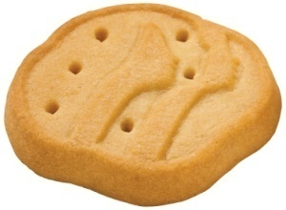

Materials Checklist (Page 6, Troop Guide)
One order card per girl (stress not to sell before Jan 20). Encourage parents to submit orders via email so girls can continue taking orders with their Order Card
One money envelope per girl
Receipt book-use for all transactions
Gift of Caring receipts-for troop records (in Boothing Kits)*
Cookie Rookie (for new troops-available online or in Service Centers)
Cookie Activity Kits*
* While supplies last
2012 Cookie Program
Notes:
Hold up each item & briefly explain.

Slide 6
5 Skills for Girls (Page 7, Troop Guide)
Decision Making
Money Management
Learns to think through and analyze situations & decision criteria
College applications…..
Budgeting; safety around cash; what to do about NSFs
Money doesn’t grow on trees
People Skills
Complaints; salesmanship; order fulfillment
It’s called Customer Service!
Business Ethics
Goal Setting
Keeping commitments;
girls sell not adults
Broken contracts have consequences
Fundamentals of what needs to happen to reach a specific goal
Science project due for school
2012 Cookie Program

Slide 7



Cookie Activity Kits (Page 8, Troop Guide)
See what a cookie can do by
visiting www.littlebrownie.com and
www.girlscoutsla.org
2012 Cookie Program

Slide 8

Training Troops For Success!
Cookie Central is the place to go for latest information:
Links to VIP eTraining
eBudde link
App information
Forms for Troops & SUs
Cookie Locator & mobile app
Link to Cookie Club
Tips & Activities from LBB
Cookie Entrepreneur Program for girls
Cookie recipes, activity kits by age level, & more!
EVERYTHING you need for a successful Cookie Program
www.girlscoutsla.org
2012 Cookie Program

Slide 9

Training Technology (Page 9, Troop Guide)
Learn at your leisure!
Videos, lessons, & quizzes
Section 5 is customized by GSGLA including eBudde guides, Troop Guides, Apps and CookieU resources.
http://vipetraining.littlebrownie.com
Note: There is a misprint in the Troop Guide. This is the correct link.
2012 Cookie Program

Slide 10



It’s all about the Apps!
THREE NEW apps make the cookie program
EASIER and PRODUCTIVE
    LBB’s “Cookie Locator” app
    LBB’s “Booth Sale Recorder” app
    Mobile “Credit Card Reader” app
2012 Cookie Program

Slide 11

Cookie Locator – App or Website
Got a SmartPhone? Download the
LBB Cookie Locator mobile
app to find Cookies Now!
When customers crave cookies…they look to the Internet. The Cookie Locator on the GSGLA website allows customers to search by zip code to find cookie booths near them.
2012 Cookie Program

Slide 12


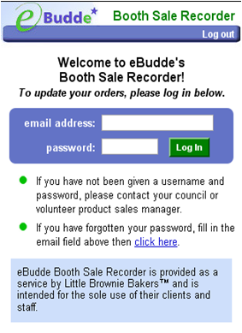
LBB Booth Recorder App (Page 9, Troop Guide)
Booth Sale Recorder
The free smart phone app that works with eBudde to record the number of cookies sold at booths and keeps track of who sold them!
The booth site recorder app is free in the App Store and Android Market. Or use the mobile website version at www.ebudde.littlebrownie.com/booth
Additional instructions and information available on Cookie VIP eTraining at http://vipetraining.littlebrownie.com
2012 Cookie Program

Slide 13
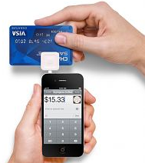
Accept Credit Cards Anywhere! (Page 10, Troop Guide)
Turn your cell phone into a mobile payments device
In 3 Easy Steps!
2012 Cookie Program

Slide 14
Accepting Credit Cards is Easy! (Page 10 , Troop Guide)
Troops can now accept credit cards using a smart phone & credit card reader (MC, Visa & Discover accepted - no AMEX).
Complete application and submit to PSM to receive reader.
Debit cards MUST have the MC/VISA logo – no PIN needed.
Authorize transactions in seconds.
Funds deposited into troop account within 2-3 business days.
Council covers the cost of credit card reader & administration.
No monthly service fees apply to the troop.
Flat 2.1% transaction fee - much lower than the standard 3%+.
$.07 fee may apply if not swiped, & for ‘Rewards’ MC/Visa.
Data charges may apply depending on cellular contract.
Ability to e-mail customer receipts directly from your phone.
Safe and secure: no data is retained in your device.
2012 Cookie Program

Slide 15
How to Download Credit Card app
DOWNLOAD
APP
ENTER ACTIVATION
CODE
PLUG READER INTO PHONE
TURN AUDIO JACK VOLUME TO MAX
Begin
ACCEPTING CREDIT CARDS
Go to
App Store
Search
“ROAM PAY”
Select “Free”
& Install
Select the
icon to run
Begin
transaction
Accepting Credit cards is easy!
2012 Cookie Program

Slide 16


LBB Cookie Club (page 11, Troop Guide)
Features
Online “ASK” Home Page
Electronic Cookie Order Form
“My Promises” Dashboard
Follow-up/Reminder emails
Troop Leader Reporting
Email gets thru spam filters
Connects directly to eBudde
Proven technique for DOUBLE the sales per customer!
2012 Cookie Program

Slide 17
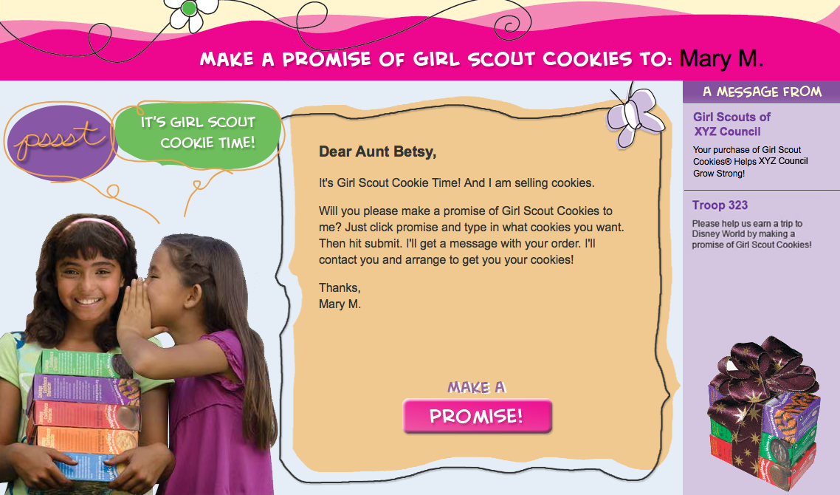
LBB Cookie Club
2012 Cookie Program
Notes:
17

Slide 18

New 100th Anniversary Cookie!
Celebrating 100 years of Girl Scouting
Cool & Crisp Lemon Cookie that reminds you of a smile if you hold it just right!
Still only $4.00/box
Savannah Smiles
2012 Cookie Program

Slide 19







Cookies (Page 12, Troop Guide)
Troop Proceeds:
75 cents/box
Opt Out Option:
Cadette, Senior or, Ambassador Troops only
5 cents/box
Opt outs are still eligible for:
All patches
Tote incentive
Club 500 & Elite 1000
Top 100
Do Si Dos
Trefoils
Thin Mints
Samoas
Thank U Berry Munch
Tagalongs
Dulce De Leche
2012 Cookie Program

Slide 20

2012 Girl Order Card
Note: Troop Incentive and Gift of Caring levels were misprinted in the Troop Guide. Correct levels are listed on the Order Card and in eBudde.
2012 Cookie Program

Slide 21



2012 Patch Design (Pages 13 , Troop Guide)
15+ Participation Patch
ROCKER PATCH
  .
500+ Achievement Rocker Patch
500+, 750+, 1000+, 1500+, 2000+, 3000+
One per girl at the highest level achieved
GOC ROCKER Patch
6+ Gift of Caring – Rocker Patch
Don’t forget about the 2012 Cookie Activity Pin from GSUSA
2012 Cookie Program

Slide 22



Special Girl & Troop Recognitions
(Pages 13, Troop Guide)
GIRL INITIAL ORDER INCENTIVE
Themed Canvas Tote Girl Incentive
200+ boxes at Initial Order ONLY
TROOP INCENTIVES
Troops averaging 200+ boxes per participating girl earn $12 for each participant
Troop Incentives
200 and 220+ PGA levels
Troops averaging 220+ boxes per participating girl earn a PopArt Peace Sign T-shirt for each participant
N
EW
2012 Cookie Program

Slide 23
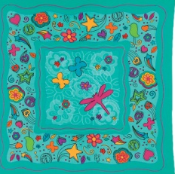
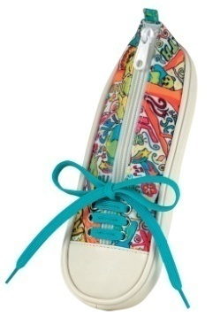

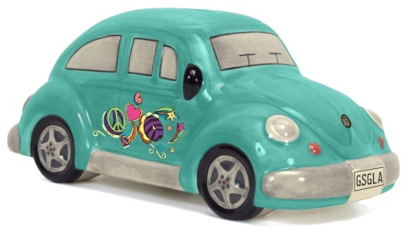
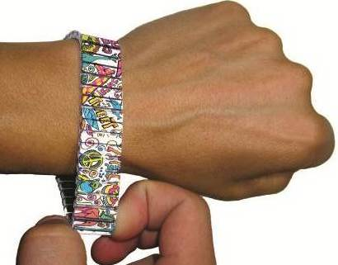
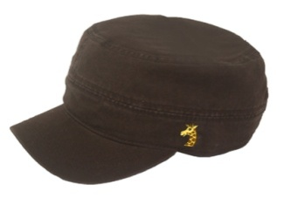
2012 Girl Recognitions (Pages 13-14, Troop Guide)
45+ PopArt Bandana
85+ Autographed
Georgia Giraffe Frisbee
155+ Cookie Mobile Bank
Council Goal!
125+ PopArt Pencil Case
250+ PopArt Bracelet
200+ Georgia Giraffe Cap
2012 Cookie Program

Slide 24
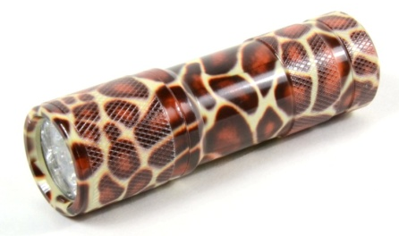

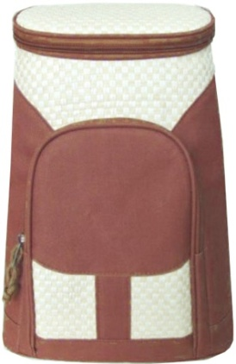
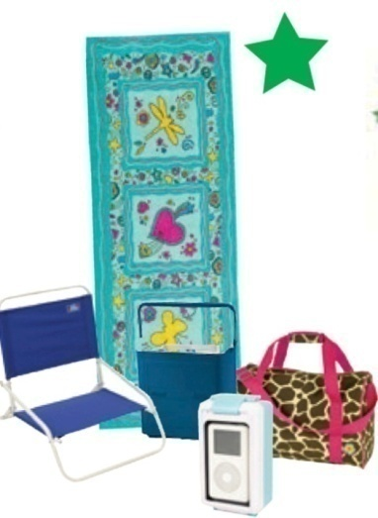
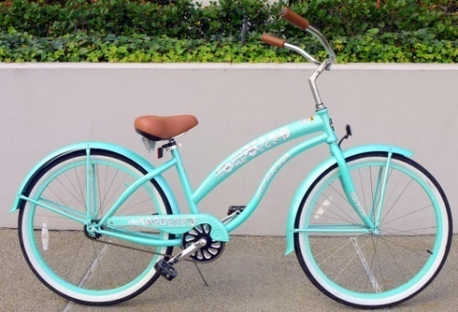

2012 Girl Recognitions (Pages 13 & 14, Troop Guide)
400+ Insulated
Lunch Backpack
Club
500
Event
325+ Giraffe LED Flashlight
FUNfest 2012
May 12, 2012
1000+ Boxes
Slumber Party
June 2, 2012
Elite
1000
Event
750+ Beach Set
PopArt Towel, Giraffe Tote, Chair, Cooler & Waterproof iPod Speaker
1500+ Beach Cruiser
2012 Cookie Program

Slide 25
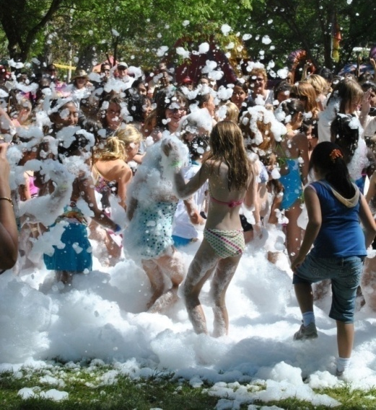
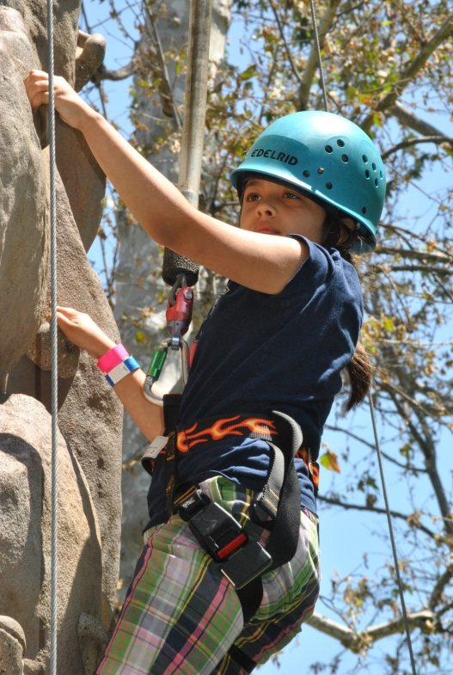
2012 Club 500
FUNfest 2012
Saturday, May 12th
Celebrate with
fun, friends & foam!
Rock climbing wall
Swimming pool
274’ waterslide
Petting Zoo
Zip lines
DJ
Carnival games & prizes
Food, food & food!
Foam cannons
Location:
Vasa Park, Agoura Hills
Girl & 1 adult only
2012 Cookie Program

Slide 26

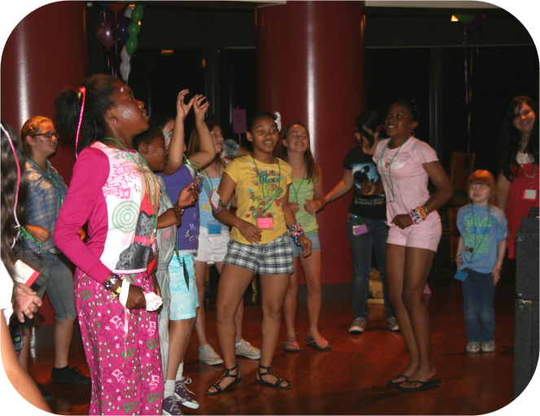
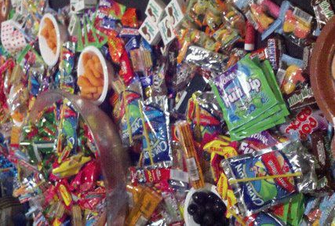
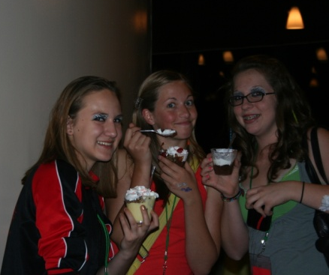
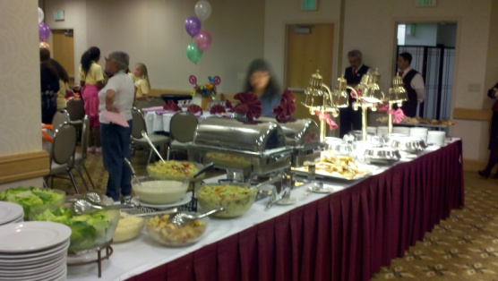
2012 Elite 1000
Slumber Party
Saturday, June 2, 2012
Girl ONLY event
Location: TBD
2012 Cookie Program

Slide 27



2012 Girl Recognitions (Pages 13 & 14 Troop Guide)
2000+
How high can you go?
“Top 100 Girls”
$400 Gift Card Choice
Disney or GSGLA
Summer Camp
3000+
The highest selling 100 girls
will receive a custom GSGLA
Sterling Silver Charm Bracelet
(actual will be revealed soon!)
Wii Collection
Wii, Wii Fit & extra controller
2012 Cookie Program

Slide 28
Safety Tips (Page 15, Troop Guide)
Follow all guidelines in Safety Activity Checkpoints and Volunteer Essentials (available online)
Collect money only when delivering cookies
Internet—cannot collect money, but may use social networking, email and promises through LBB’s Cookie Club.
Adult supervision at all times.
Do not carry large amounts of cash.
Remit cash & checks to the troop “promptly & frequently.”
2012 Cookie Program
2011 Cookie Program
Notes:
Review safety tips on Page 11 troop guide.

Slide 29
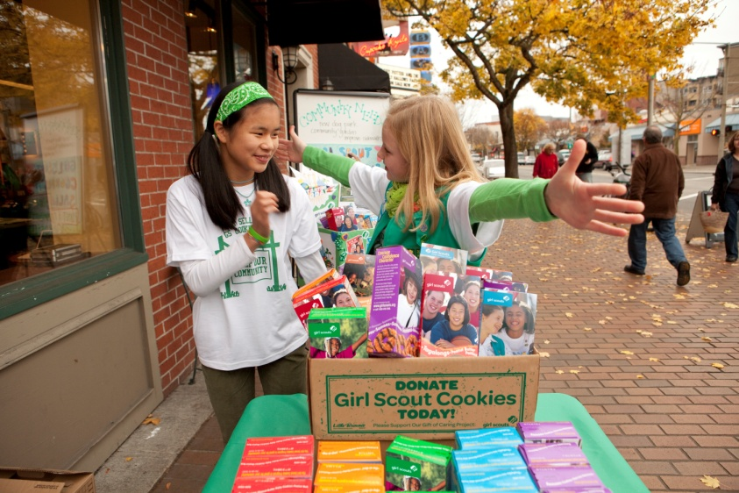
Selling Tips (Page 16 & 17, Troop Guide)
Door to Door Sales-order card or cookies in-hand.
Telephone sales-quick & easy! Utilize last year’s order card to build a customer base!
Internet—Cookie Club, social networking (ages 13+).
Try a Text-a-thon (with parent permission) to let friends and family know it’s cookie time!
Workplace sales.
Cookies for a Change! Council-wide
Gift of Caring Program.
2012 Cookie Program
2011 Cookie Program

Slide 30


Gift of Caring Partners (Page 18-19, Troop Guide)
Los Angeles Regional Foodbank
  Distributes to 100+ LOCAL food banks
Bob Hope Hollywood USO at LAX
  Hospitality Suite for arriving/departing service men & woman
  Operation Gratitude
  Sends care packages to those on active duty in conflict areas
  Blue Star Mothers
  Hospital visits, care packages
  Goodwill Southern California
  At-risk youth mentor programs
In 2011, 20 girls sold 100+; 3 girls sold 500+ and top GOC seller was 1294.
Gift of Caring is not an add on sale, it’s a Business Model!
2012 Cookie Program

Slide 31
Essential Program Tools (Available online)
Everyone can learn something new from the latest version of
Cookie Rookie
Cookie Rookie & 5 Skills
are available on the
GSGLA website
Many successful business women and community leaders say they got their start selling Girl Scout Cookies.
Shaping Your Girl’s Future
2012 Cookie Program

Slide 32



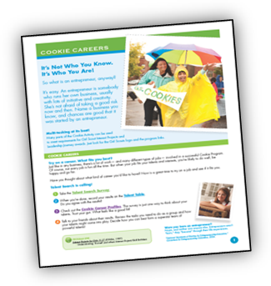

CEOs –we’re not kidding! (Available online)
Business Card Templates
PowerPoint Templates
Thank You Cards
eGrams
Marketing Plan
Goal Action Planner
2012 Cookie Program

Slide 33





Internal Communication (Pages 20-21, Troop Guide)
Cookie Program Family Guide
CookiEgrams
Online Resources - website/GSGLA Facebook
“GSGLA Cookie & Nut Friends” Facebook
  Everyone should “LIKE” this page and post to your own Facebook page, as appropriate
2012 Cookie Program

Slide 34


External Communication (Pages 20-21, Troop Guide)
Billboards, Mall Network, Cinema Ads
Online & Print ads & Radio PSAs
Social Media
Official Booth Site Posters
Press & Media Coverage
Millions of customer impressions will saturate the marketplace – talk about !
2012 Cookie Program

Slide 35

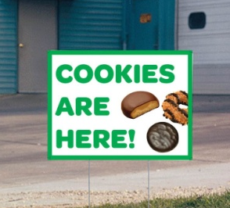

Be a Marketing Guru! (Pages 20-21, Troop Guide)
Troop Boothing Kit
Super Booth Kit in Retail Shop
Download & use website resources
Utilize your networks (on and off-line)
Represent Girl Scouts with pride!
  Wear uniform/sash, pins, colors
  Be prepared to “speak Girl Scout!”
  Smile and say thank you!
2012 Cookie Program

Slide 36

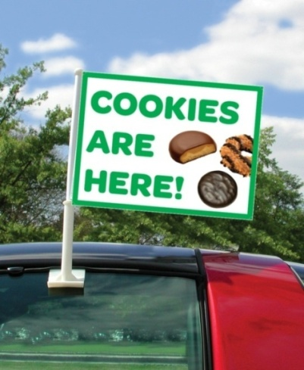
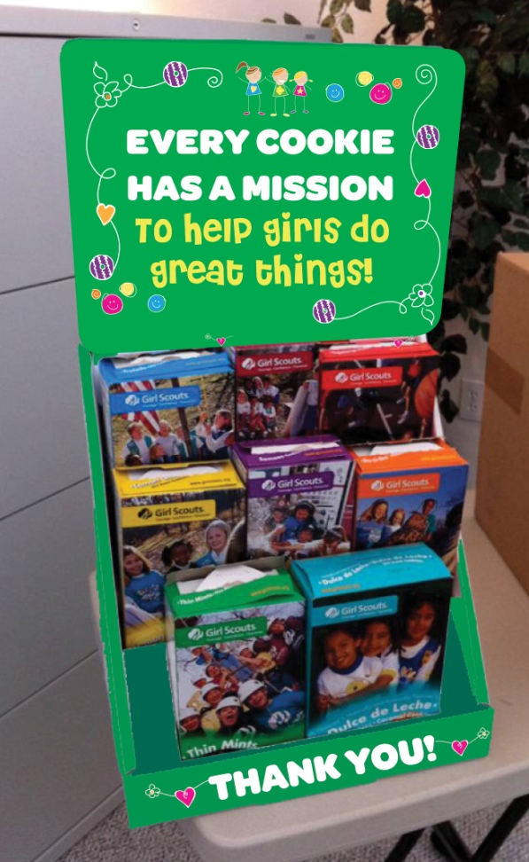
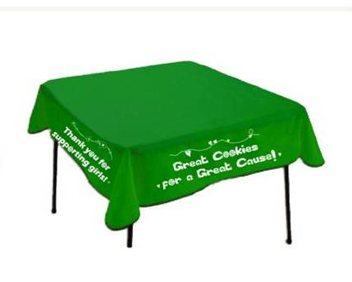

Marketing Tools for Troops (Available at Council Shops)
Available for purchase from your Council Shop!
Car Flags
Balloons
Available for Rent at your Service Center:
11’ Cookie Banner
Cookie Costumes
(free use w/deposit)
Cookie Display
Custom Tablecloths
Yard Signs (not pictured)
2012 Cookie Program

Slide 37
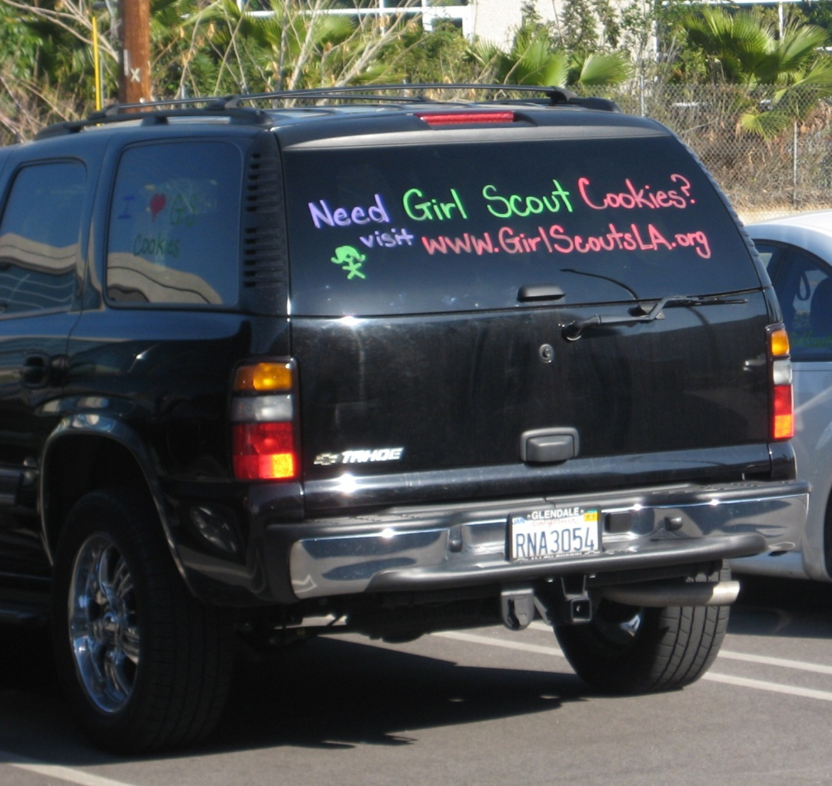
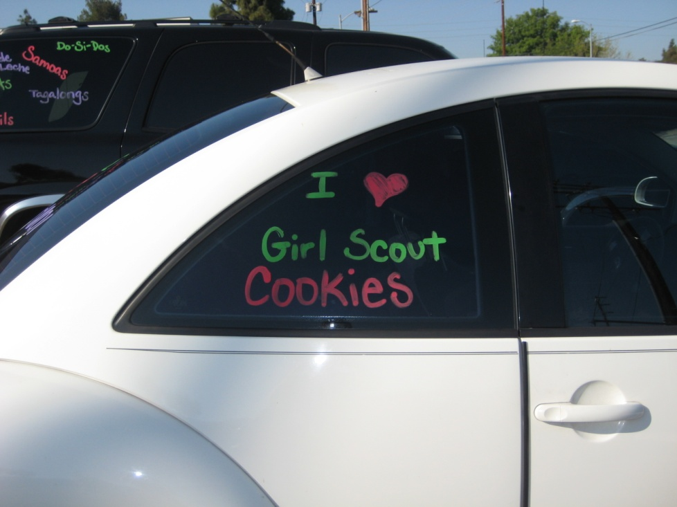
Car Chalk Decorating
Tell the world you’ve got Cookies!
Available for your use at most cupboards
2012 Cookie Program

Slide 38

Into the 21st Century
“GSGLA Cookie & Nut Friends”
Join the Conversation!
Leaders, Cookie Chairs, parents & girls! Get the latest GSGLA Product Program information delivered directly to your Facebook newsfeed.
Share your stories & photos
Get marketing ideas for troops & girls
Product Information
Tools
And More!
Be sure to LIKE our page
“GSGLA Cookie & Nut Friends”
2012 Cookie Program

Slide 39
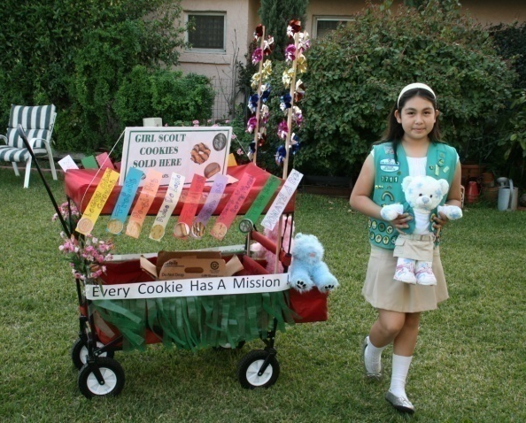
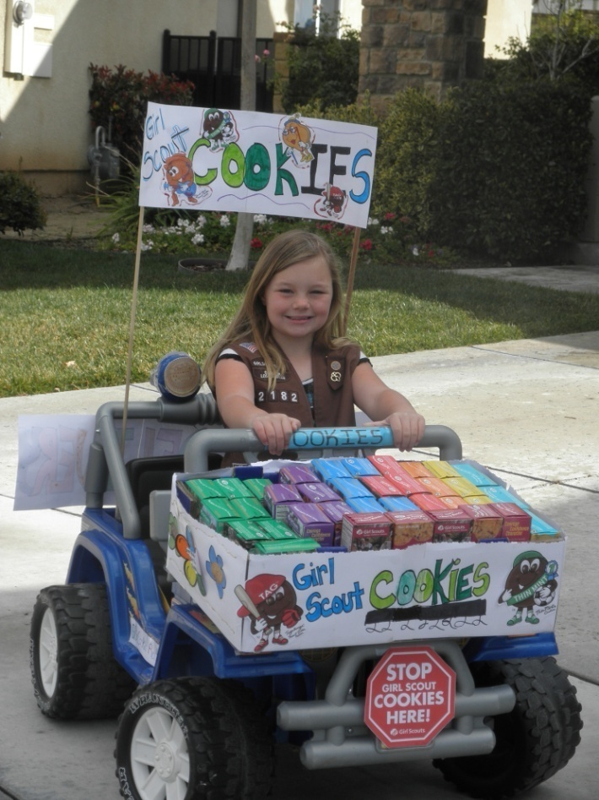
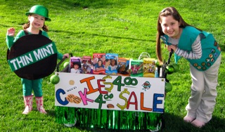
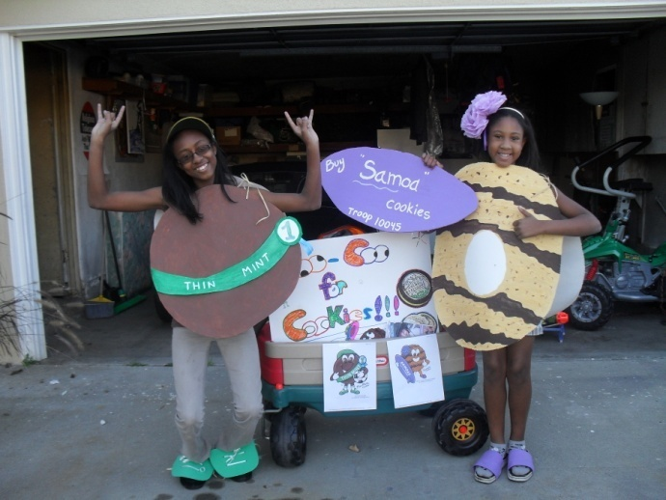

2nd Annual Cookie Mobile Contest
“Bling that Booth”
and take it on the road!
Contest rules can be found at www.girlscoutsla.org
2012 Cookie Program

Slide 40


What Can a Cookie Do?
Win a $250 GSGLA Gift Card for your Troop!
“What Can A Cookie Do?”
Troop Cookie Goal-setting Video Contest
Like "Pasadenafcu" on Facebook to stay updated on the latest contest information.
Contest open March 1 – April 13, 2012
Additional rules and details available on the PFCU Facebook page.
"Like" the GSGLA Facebook page for the winner announcement.
PFCU offers FREE troop checking accounts!
2012 Cookie Program

Slide 41

Troop Setup (Page 22, Troop Guide)
User friendly for volunteers!
Excellent support: online, manuals & live webinar learning
Demo site access http://ebdemo.littlebrownie.com
SUCCs add TCCs to the system
Troops & girls pre-loaded - Update info, add/delete as necessary
New roles allow more visibility for additional troop volunteers
Direct connection to Cookie Locator app and Booth Sale recorder app
Manage recognitions order
More troop control
2012 Cookie Program

Slide 42
Initial Order Instructions (Page 22, Troop Guide)
By January 20, make sure all paperwork has been turned in to your SUCC so you can be invited into eBudde.
By February 3, set up your troop, verify banking information, add Contacts, add/edit girls (for graceful ordering, complete this step early!)
By February 5, Troops must enter and SUBMIT I/O into eBudde by 11:30PM
Auto Roundups are now automatic, not a separate step.
Initial Orders are entered for each girl in boxes. eBudde will automatically round up your troop’s order to full cases for delivery day.
Make sure to include a booth sale order to avoid long lines at the cupboard!
Choose preferred delivery time on delivery tab (time subject to approval by SUCC or Delivery Chair)
2012 Cookie Program

Slide 43





Initial Order Pick-Up (Pages 22-23, Troop Guide)
Be on time for your pick-up! If your troop is bringing more than one vehicle, make sure they arrive together.
Troops bring a print-out of their order from eBudde to the delivery station.
Count, count, count everything before you load your vehicle and sign your receipt!
Do not separate girl orders at the delivery station!
Do not store product in a car, direct sunlight, a garage, on a cement floor, porch, patio, or in any warm place!
Do separate girl orders before notifying families that product is in.
Prepare an M-3 receipt for each family picking up product.
Distribute girls’ money envelopes with their product.
KEEP ALL SIGNED RECEIPTS!!
2012 Cookie Program

Slide 44
Cupboard Information (Page 24, Troop Guide)
Find cupboard locations and schedules on the GSGLA website www.girlscoutsla.org – Click on the “Cookies and Nuts” tab to get to Cookie Central!
Cupboard schedules differ at each location, check before you go!
Place a “Pending Order” – 48 hours notice is preferred
Cupboard orders are placed in boxes (multiples of 12) and picked up in cases only until March 15.
Troops should not contact the cupboard manager unless a telephone number/email is listed. Most cupboards are not staffed to handle telephone calls and/or emails.
Cupboard customers should remember that most cupboard managers are volunteers, too, and should be treated accordingly!
2012 Cookie Program

Slide 45

Cupboard Policies (Page 24 & 25, Troop Guide)
General
Case quantity until March 15; then to the box until the end.
Troops may pick-up product at any GSGLA cupboard.
Pending Orders in eBudde are strongly suggested/requested.
48 hr in advance; pending order is not a guarantee; deleted 2 days post
Names MUST be entered in eBudde to be authorized to pick-up cookies.
Authorization to Pick-up Product Forms; for cupboards w/out computers.
Authorized contacts should be prepared to show ID.
Exchange Policy
Damages are exchanged for like product only.
March 15 – 22 only! Pick-ups after March 22 are FINAL.
At designated cupboards only. Check before you go!
Place exchange pending order to speed you through.
2012 Cookie Program

Slide 46


Booth Scheduler (Page 26, Troop Guide)
Troops choose and schedule their own booth sale shifts online.
  Compare your calendar to available shifts and reserve!
Know what your boothing schedule is immediately.
Cancellation is a click! - Just sign into eBudde, click to release the shift, and you are done.
The cancelled shift immediately shows up as available to other troops!
Council-wide boothing opportunities for everyone!
Limited to their home service unit for first round of sign-ups.
Real-time data into the LBB Cookie Locator and mobile app.
Allows customers looking for cookies to find your booth from the listing.
Katie
Cheri
Jacqueline
Erlinda
Steph
Tamar

Slide 47
Booth Scheduler Details (Posted online only)
First round -- sign-ups are limited to the Home Service Unit only
Your Boothing Chair or staff will monitor the sign-ups and report any out of area reservations as necessary.
Open/close time is always 6:30 PM
Order cookies for your first booth sales at I/O in order to lessen wait times at the cupboards.
Round Open Close # Choices
Home Area
1
2
3
4
Sun, Jan 29
Tues, Jan 31
Thurs, Feb 2
Tues, Feb 21
Mon, Jan 30
Wed, Feb 1
Fri, Feb 3
Does not close
2
3
4
N/A
Any Area
Troop I/O Due Sun, Feb 5th
11:30 PM
Average Troop = 6 booths
2012 Cookie Program

Slide 48




Boothing Guidelines (Page 27 & 29, Troop Guide)
Boothing is a privilege. Respect each other and host businesses - uphold GS Promise & Law!
Ask customers on the way out only and thank everyone!
Two adults required, no more than four girls (recommended).
Do not leave any trash (including cookie boxes) at the booth site.
Be sure to thank the site manager.
Conflict? Problem? You are the face of Girl Scouts! Settle disputes away from girls and customers and be respectful and considerate at all times. Contact your SUCC, Boothing Chair or PSM if needed.
Out of council girls selling in LA? Get a troop #, name, and report details to your PSM. There are consequences for breaking rules.
2012 Cookie Program

Slide 49
Successful Boothing (Page 28, Troop Guide)
Girls should know:
How to approach customers with their Cookie Pitch!
Cookies offered and the price ($4 per box or 5 for $20!)
How to behave at a booth site (wear uniform and no goofing off!)
About the council-wide Gift of Caring Program!
What the troop plans to do with their proceeds!
For Adults:
Make sure all adults picking up cookies are listed in eBudde.
Be familiar with Safety Activity Checkpoints and boothing guidelines.
Adults may assist, but cannot sell cookies!
Bring cash box & change, Troop eBudde confirmation, GoC receipts, boothing kit (available from your SUCC).
Method to track sales (utilize Booth Sale Recorder App!)
Make sure to release shifts you cannot attend!
Teach girls selling strategies & how to improve their Cookie Pitch each time.
2012 Cookie Program

Slide 50
Cash Handling (Page 31 & 32, Troop Guide)
Girls’ Monies:
Girls must be registered and have a Parent/Guardian Permission & Responsibility Agreement on file with the Troop Leader.
Checks payable to “Troop ____.”
Do not accept one check from parent. Parents DO NOT deposit into personal accounts to remit to troop.
Do not accept money before delivering cookies (GoC is exception).
Girls should hand in money at every opportunity.
Accept credit cards via the new smart phone app to get the money where it needs to be safely and securely.
Troops’ Monies:
Deposit money into bank account “promptly & frequently.”
Use receipt books for ALL transactions/record payments in eBudde.
Debit is pulled from the info in eBudde. Routing # is 11 digits, starts with 1,2,3. Account # is 2nd set of digits.
2012 Cookie Program

Slide 51
Tracking Sales: (Page 32, Troop Guide)
Initial Orders are FINAL and cannot be changed.
  Do not input I/O under a girl’s name unless they have orders for those cookies.
  Do not add a girl until they have participated for accurate PGA.
Enter first and last name for each girl.
Utilize booth sale order for extra product - do not make up names.
After I/O, cookies must be allocated back to girls (from cupboard, roundup or initial booth sale) to insure girls receive credit for boxes sold.
All recognitions are based on troop’s recognition order. TCCs now SUBMIT recognitions order in eBudde.
Troop-to-troop transfers are inputted by troop releasing the cookies.
2011 Cookie Program

Slide 52

Debt Management (Page 32, Troop Guide)
Two New Cookie Policies
$300 parental credit limit for bad debt
  Troop cannot not collect (i.e. “they didn’t turn it in”)
  Girl order should have a customer behind it
  This helps Troop to collect for 1st ACH Debit and during boothing
Troops responsible for NSF fees caused by negligence
Troop knows due dates and amount due.
Troop authorizes direct debit via signed ACH Debit Authorization form.
  Troop Chair agreed to “managing my troop’s Cookie Program including all sales proceeds and ensuring that the funds are deposited into our troop account by the deadlines outlined.”
  Like any mortgage or bill, proceeds are due on the dates specified.
  Troops must communicate any issues PRIOR to debit date.
  Troops will be assessed $25 NSF fee for each returned ACH Debit.
2012 Cookie Program

Slide 53
Final Wrap Up
Complete Troop-to-Troop transfers.
Allocations for proper girl counts – encourage the Booth Sale Recorder App to streamline.
Finalize girl recognitions – enter sizes, or make choices, if applicable. SUBMIT when ready.
No debit “authorizations” – must email PSM for payment issues.
Payments to Council are “automatic” – on the calendar.
Troops must take ownership of their obligations, pay on time and deliver Discrepancy Reports on time.
Girl and troop recognitions are delivered to Service Units May/June. Please pick-up and distribute promptly!
2012 Cookie Program

Slide 54
Communication is key!
Meeting deadlines is the key to your success! TCCs should check their email EVERY day for updates from SUCCs to stay on track!
Read CookiEgrams to stay in the know & ahead of due dates!
LIKE the “GSGLA Cookie & Nut Friend” Facebook page!
Utilize online resources for training!
Communicate often with girls and parents.
Hold parent meetings!
Parent meetings are a great way to introduce parents to the Cookie Program, share what the troops goals are and recruit volunteer help. Troops who hold parent meetings are more successful at reaching their goals!
Emails to SUCC & GSGLA should include Troop #/SU in subject line. Make sure to include name and phone number in your correspondence so we can assist you efficiently!
2012 Cookie Program

Slide 55
Conclusion
Questions?
2012 Cookie Program

